Slide 1
WELCOME (Splunk Fundamentals)
Mark Your Attendance:
Go to the Course Calendar Invite
Click on the Course Event Link
Press Check-In
Notes:
[MANDATORY SLIDE]
Please remind students at the beginning of class and before taking lunch to check in and copy and paste the message below in the chat: Please remember to check-in by going here https://sfdc.plusplus.co/checkin/

Slide 2
SPLUNK FUNDAMENTALS

Slide 3
Outline
About Splunk
Introducing Splunk and the Search App
Run basic searches
What Splunk is not good for
Recommended Log Formats
Lab
Identify the contents of search results
Control a search job
Use the output of a search to refine your search

Slide 4
Outline
Fundamentals
Examine the anatomy of a search
Understand search language syntax concepts
Review fields and use the fields command
Create a table
Examine multivalue fields
Joins
Parallel Coordinates Query

Slide 5
Outline
Stats
Understand the stats command
Display top and rare values for given fields
EventStats vs StreamStats
Tags and Event Types
Understand the eval command
Perform calculations on field values
Convert round and format field values
Use conditional statements

Slide 6
Outline
Using REX and RegEX
Creating Reports
Create reports and charts
Chart Functions
Split values into multiple series
Apply statistical functions

Slide 7
Splunk
Chapter 1
Start Searching

Slide 8
Course Overview
Start Searching
Fundamentals
Stats
Tags and Event Types
Creating Reports

Slide 9
Outline
Introduce Splunk and the Search app
Run basic searches
What splunk is not good for
Recommended Log Formats
Identify the contents of search results
Control a search job
Use the output of a search to refine your search

Slide 10
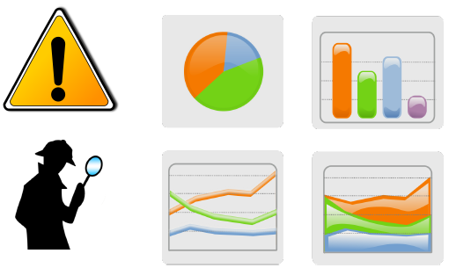
What is Splunk?
Operational Intelligence
Data visualization
Alerting
Reporting
Investigation
Machine-data

Slide 11
About Splunk
History :
The story of Splunk began in 2002, when co founders Erik Swan and Rob Das started looking around for their next challenge. Erik and Rob had done a couple of startups together and were looking for an idea for a new venture, so they started talking to companies about their problems.
Q to Industry : How do they solve problems infrastructure issues?”
Ans : Traditional troubleshoot techniques,poring over log files, sometimes writing scripts, etc as data was too widespread.

Slide 12
About Splunk
Idea : “Why couldn’t searching IT data be as easy and intuitive as a GoogleTM search?”
Answer : Splunk

Slide 13
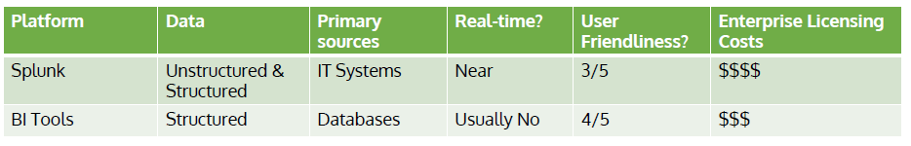
What is Splunk?

Slide 14
Splunk and Data
Central Data repository : Data from many different sources is centralized for searching.
Data Insights : Converts data into answers and helps you find the insights that are buried in the data.
Understand the structure and meaning of data : The more you understand your data, the more you’ll see in it and helps you capture what you learn to make future investigations easier and to share what you’ve learned with others.

Slide 15
Splunk and Data
Visualization : All that indexing and searching pays off when you see a chart or a report that makes an answer crystal clear. Being able to visualize data in different ways accelerates understanding and helps you share that understanding with others.

Slide 16
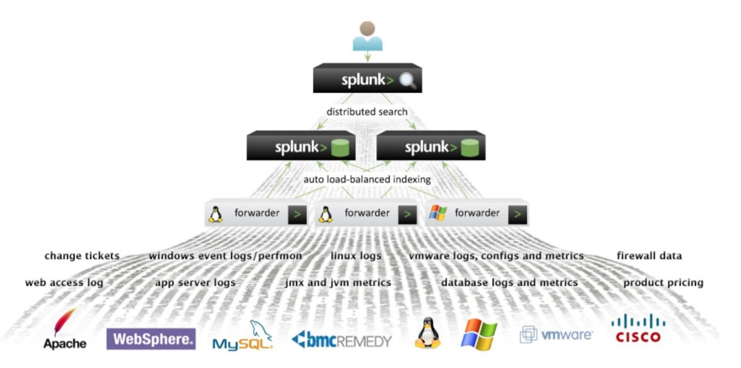
Splunk Architecture/Overview

Slide 17
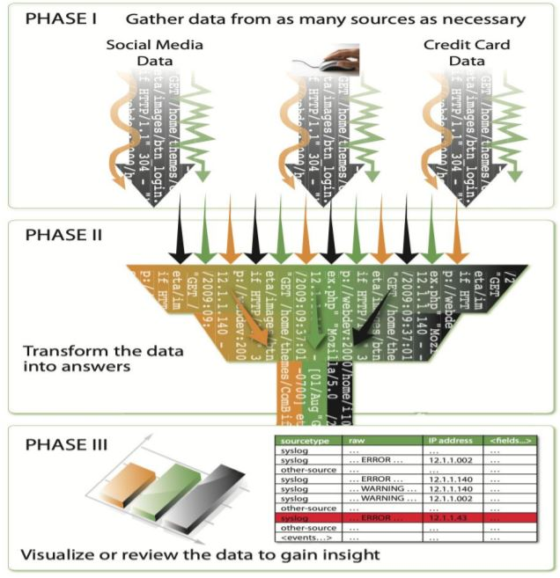
Three Phases of Splunk

Slide 18
Splunk Use in Industry
It has a lead on log management, SIEM and Data Analytics tool and is widely used in industries such as finance, utilities, healthcare and manufacturing for use-cases including security, compliance and IT service monitoring.
It helps you to do the following :
identify the data that can answer your question.
transform the data into the results that can answer your question.
display the answer in a report, interactive chart, or graph to make it intelligible to a wide range of audiences.

Slide 19
Install / Download
Get the latest build of Splunk and install it on your machine or can login to cloud or use pour setup on AWS.
Local Splunk (.exe)
Vagrant with VM’s (Virtualbox images )
Kubernetes (on docker with kubernetes)
License options.
• Splunk licensing is based on how much data per day you index into Splunk for searching.

Slide 20
Install / Download
The free license will let you index up to 500MB per day.
Get a development license for their personal workstation. This will let you index up to 10GB per day and unlock all the enterprise features.
Change your default admin password on Splunk once you login for the first time.

Slide 21
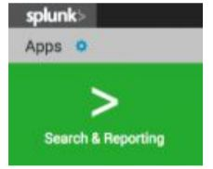
Start Searching: The Search App
The Search App
Find Splunk Search
If you are not on the Splunk Home page, click the Splunk logo on the Splunk bar to go to Splunk Home.
From Splunk Home, click Search & Reporting in the Apps panel.

Slide 22
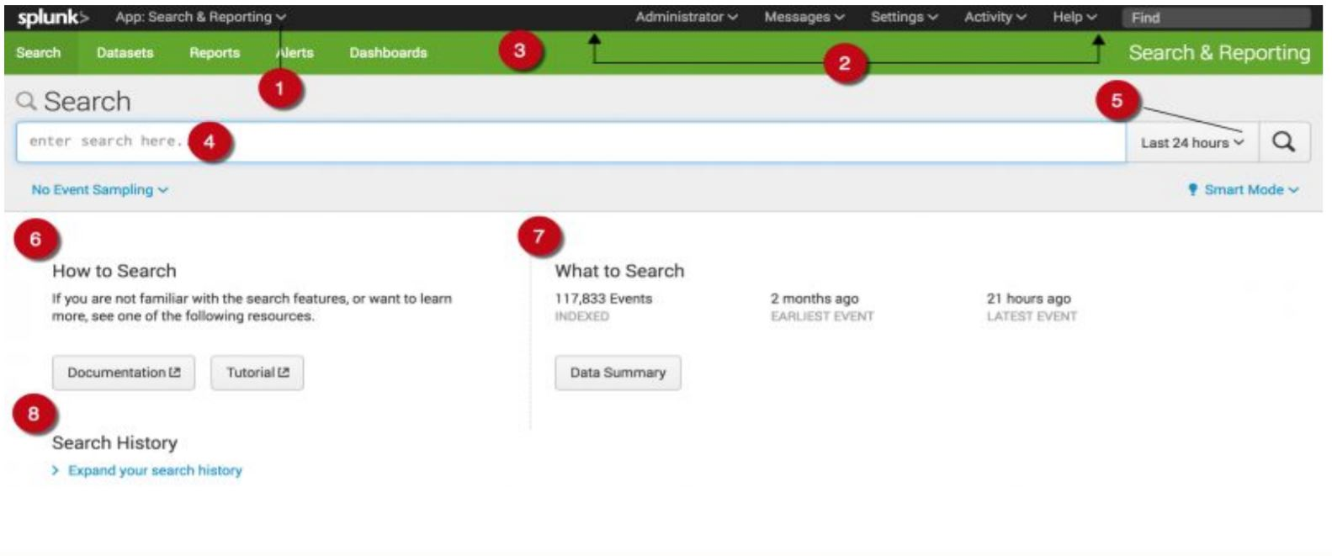
Start Searching: Search Menu Bar

Slide 23
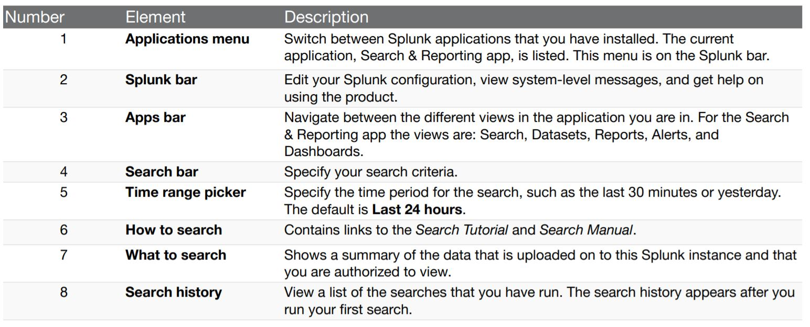
Start Searching: Search Menu Bar

Slide 24
Start Searching: Splunk Apps
Wait!, did I say Apps ?
What are apps in splunk?
A Splunk application is a bundle of configurations, scripts, saved searches, visualizations etc as they are objects within Splunk. Sure an application can have code in the form of scripts such as python, shell, powershell etc.
But it is generally more than that and yet can be as simple as nothing but as a single configuration file. That is something I do often for defining log file monitoring for specific application types.

Slide 25
Start Searching: Splunk Apps
I make an \”app\” that is a single inputs.conf file for picking up apache logs outside of /var/log on a *nix system that might be common across a cluster of web application servers. Then I assign that app to just those systems and boom, those logs are picked up and shoved into the desired index within Splunk.

Slide 26
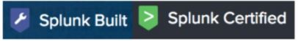
Splunk Apps
Apps extend Splunk’s Functionality
Apps can be created by third parties, individuals or Splunk
Apps that are built by Splunk carry the “Splunk built” logo
Apps that are certified by Splunk carry the “Splunk Certified” logo
Other Apps may not have passed the Splunk Certification, but that does not mean they aren’t useful!

Slide 27
Splunk Apps
Apps are downloaded from Splunkbase.com
Most apps are free, however there are a few premium apps for which you will need a license
These include:
Splunk App for Enterprise Security
Splunk App for PCI Compliance
Splunk app for VMware
Splunk App for Microsoft Exchange

Slide 28

The Search App>
The “main” user interface for Splunk
Where you go to search, create reports, create dashboards, and much more

Slide 29
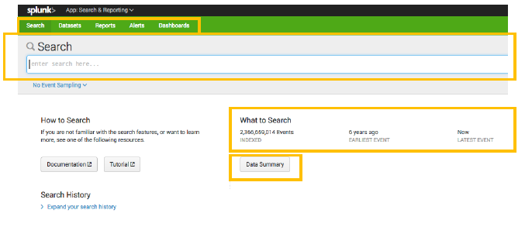
The Search App>
The summary page is the starting point for many Splunk operations

Slide 30
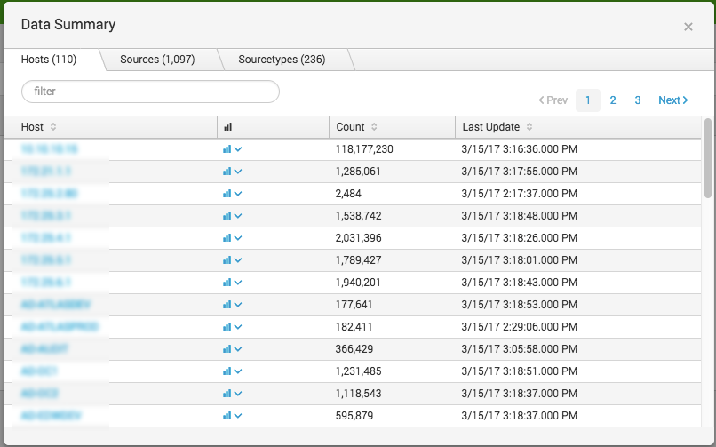
The Search App>
The Data Summary view
Shows everything that’s “calling home,” as well as its metadata

Slide 31
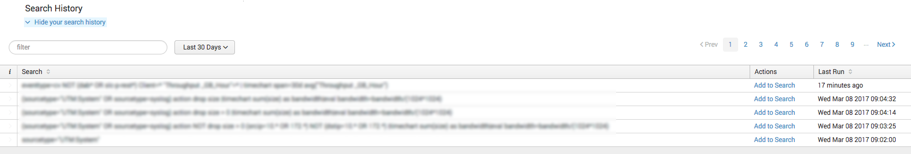
The Search App>
The Search History
Shows a history of searches you’ve performed

Slide 32
Course Overview
Introduce Splunk and the Search app
Run basic searches
What splunk is not good for
Recommended Log Formats
Identify the contents of search results
Control a search job
Use the output of a search to refine your search

Slide 33
Basic Searching
Basic search terms (building blocks)
Keywords
failed, error
Phrases
“failed login”
Fields
Key value pairs
user=user1.domain.com
Wildcards
*ailed, fail*, user=*
Booleans
Case sensitive (upper)
AND, OR, NOT

Slide 34
Basic Searching
Basic search commands
chart / timechart
Returns results in tabular output for charting
rename
Renames a specific field
sort
Sorts results by specified fields
stats
Provides statistics
eval
Calculates an expression
dedup
Removes duplicates
table
Builds a table with the specified fields

Slide 35

Splunk
LAB 01: Run Basic Searches

Slide 36
Run Basic Searches: Lab time
Feed data and play with it
Example :
Let's find no. of users from the logs
Navigate Search app

Slide 37
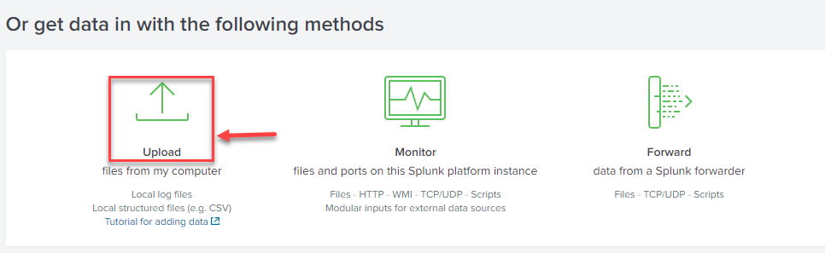
Load DataSet
Upload userdataset data in Splunk

Slide 38
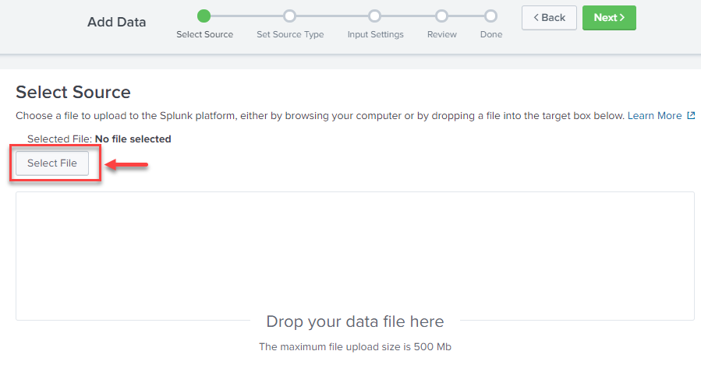
Load Dataset

Slide 39
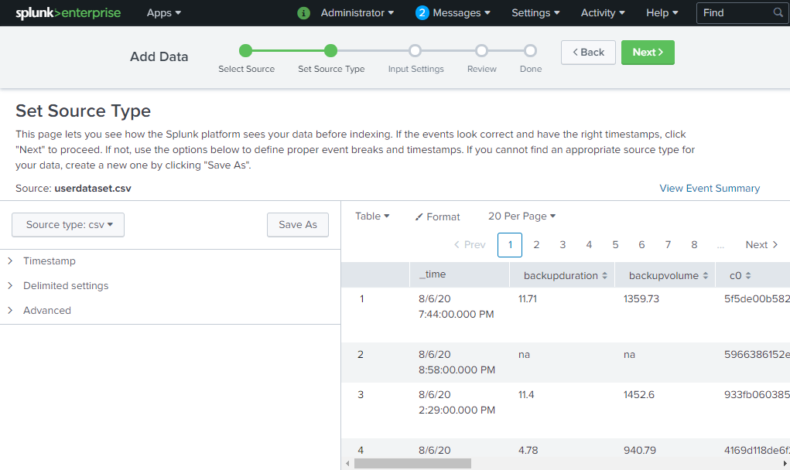
Set the Default Source Type

Slide 40
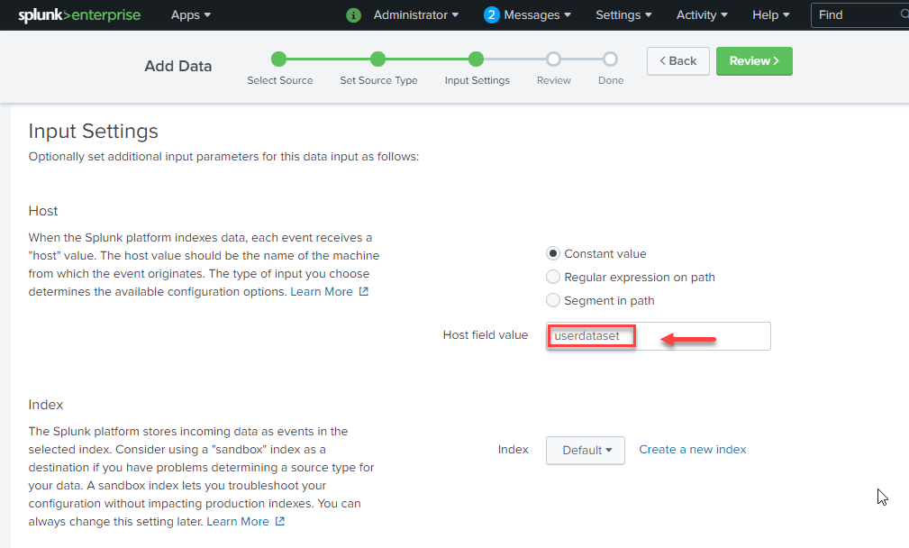
Set Host Field Value

Slide 41
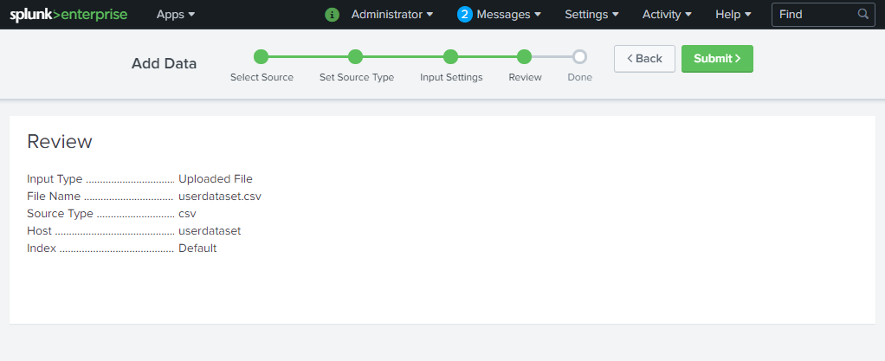
Review

Slide 42
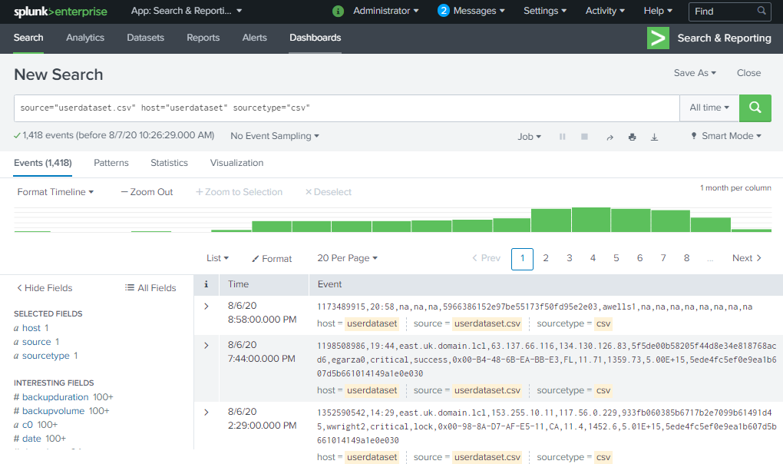
Enter New Search Query

Slide 43
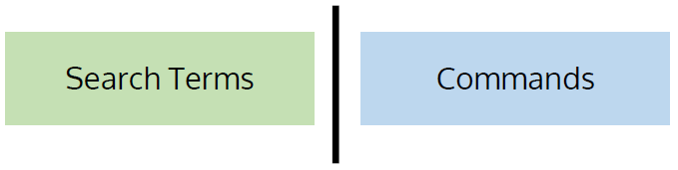
Basic Searching
Constructing a basic search
host="userdataset" domain=* usr=* type=fail* OR lock* | table _time usr domain type | rename _time AS Time usr AS User | sort -Time

Slide 44
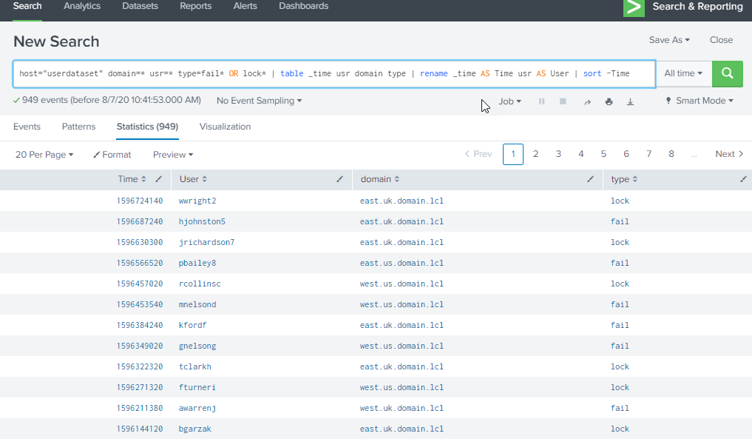
Result

Slide 45
Splunk
END LAB 01

Slide 46
Outline
Introduce Splunk and the Search app
Run basic searches
What splunk is not good for
Recommended Log Formats
Identify the contents of search results
Control a search job
Use the output of a search to refine your search

Slide 47
What Splunk is not good for
Not an Open Source
Expensive
Licensing
Not a Data science tool like jupyter
Data Ingestion :
Splunk works very well with certain kinds of data–particularly time series data and log files. However, if your data doesn’t fit that description, you very well may encounter serious difficulties getting your data into Splunk. In contrast, both Python and R have a robust collection of modules which will enable you to parse all kinds of data quickly, easily and without having to pay licensing costs or move the data around.

Slide 48
Outline
Introduce Splunk and the Search app
Run basic searches
What splunk is not good for
Recommended Log Formats
Identify the contents of search results
Control a search job
Use the output of a search to refine your search

Slide 49
Recommended Log Formats : Log Formatting
Use clear key-value pairs : timestamp key=value key=value key=value key=value key=value key=value key=value key=value
Create events that humans can read : [Timestamp] Hostname HostIP=IPaddress Service=ServiceName ClientIP=IPaddress SrcPor=port# DestPort=port# UID=value
Use timestamps for every event : Timestamp] Hostname HostIP=IPaddress Service=ServiceName ClientIP=IPaddress SrcPor=port# DestPort=port# UID=value

Slide 50
Log Formatting
Use unique identifiers (IDs): Timestamp] Hostname HostIP=IPaddress Service=ServiceName SrcPor=port# DestPort=port# UID=value AnotherImportantValue=uniqueID
Log in text format:
For example, don't log the binary data of a JPG file, but do log its image size, creation tool, username, camera, GPS location, and so on.
Use developer-friendly formats: { "sender" : "michael" "recipient": { "name" : "michael", "name" : "andrea", "name" : "itay" }
Log more than just debugging events:

Slide 51
Log Formatting
Use categories : For example, use the severity values INFO, WARN, ERROR, and DEBUG.
Identify the source: Include the source of the log event, such as the class, function, or filename.
Keep multi-line events to a minimum:Multi-line events generate a lot of segments, which can affect indexing and search speed, as well as disk compression.

Slide 52
Log Formatting
Consider breaking multi-line events into separate events.
Log locally to files :
Use Splunk forwarders
Use rotation policies
Collect events from everything, everywhere

Slide 53
Outline
Introduce Splunk and the Search app
Run basic searches
What splunk is not good for
Recommended Log Formats
Identify the contents of search results
Control a search job
Use the output of a search to refine your search

Slide 54
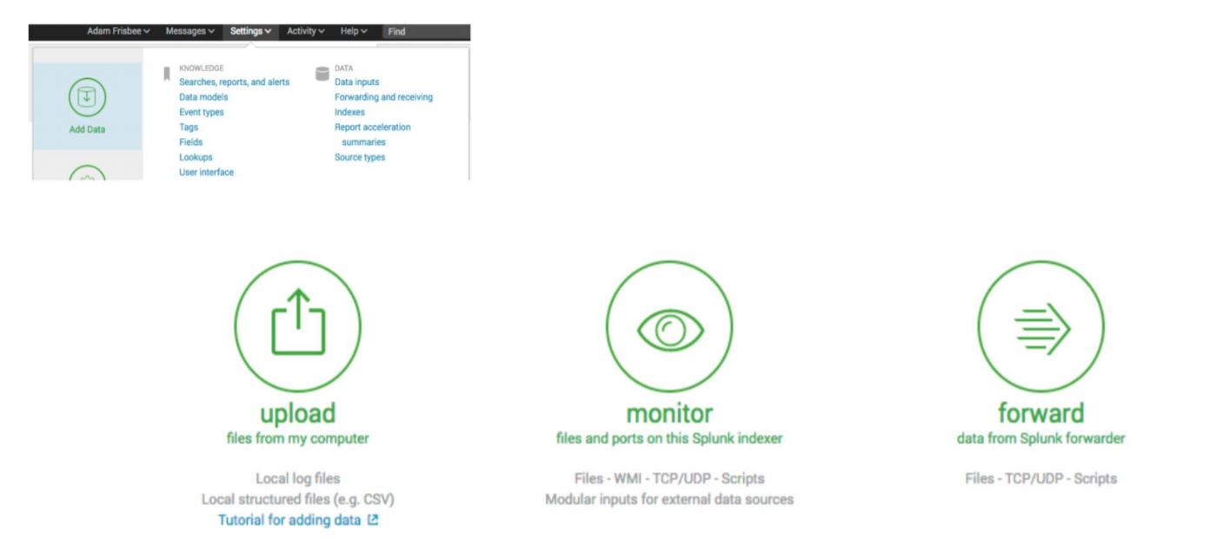
Feed Data into Splunk and Index

Slide 55
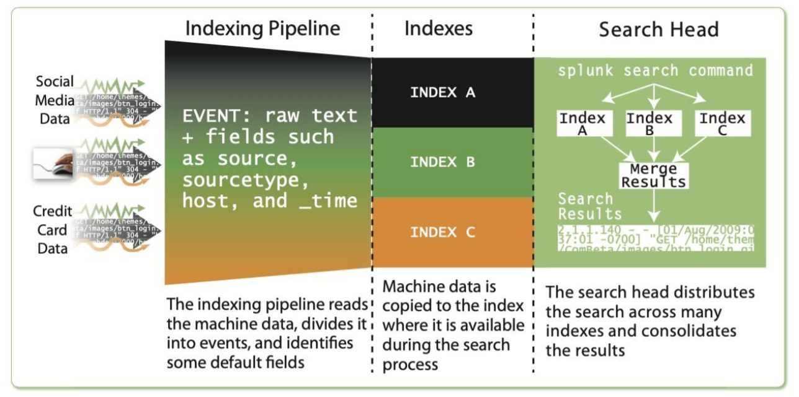
Understanding How Splunk Indexes Data

Slide 56
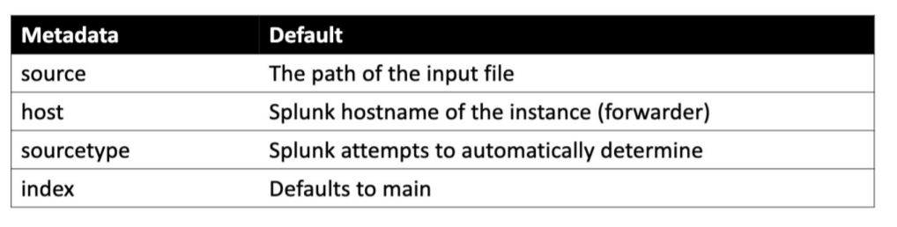
Let’s check the data
That’s so meta
Splunk automatically assigns metadata to the entire source unless you specify what the metadata should be
The default metadata assignments are as follows

Slide 57
Indexes
The repository for data. When the Splunk platform indexes raw data, it transforms the data into searchable events.
Indexes reside in flat files on the indexer.
There are two types of indexes:
Events indexes. Events indexes are the default type of index. They can hold any type of data.
Metrics indexes. Metrics indexes hold only metric data.

Slide 58
Indexes
In general, the act of processing raw data and adding the processed data to an index. Specifically, indexing is the third segment of the data pipeline, in which the indexer takes parsed events and writes them to the search index on disk.
Indexes are how you control access to data and it’s retention period.

Slide 59
Importance of Indexes
Scenario : Consider a “traditional” starting splunk deployment by a security group. You get the IT group to install the universal forwarder sending you logs. Up front they aren’t interested in more than making you go away so they can work the next support ticket. Later, they find out how much access to their own logs in splunk can help operations succeed. Everything is all mixed together; your IDS, mail logs and web logs. Maybe a lot they don’t need to see.
Splunk will put data into the index named “main” by default. Everyone with a login to splunk can see this index. There is no simple move command once data is in an index to shift it into a new one. It gets to be a bigger mess when start installing apps. Some like the *nix app put everything into an index called “os”.

Slide 60
Naming Convention
You should setup different indexes as early on as possible in a new deployment. Above all use a naming convention. Sticking with the default retention period is ok. It’s six years, so you have time to shrink it later. I follow this naming convention.
* os_windows_groupname
* os_linux_groupname
* os_windows_groupname_secondgroupname

Slide 61
Naming Convention
I use underscores in index names.
This type of index is for OS related logs so it starts with os_.
The first and often only groupname is the IT or organizational group that owns the systems and provides the logs.
Optionally what if you have a system developers and IT admins need to share log access. That is where I add _secondgroup name to it and send events for just those systems to this index.

Slide 62
Naming Convention
Searching with wildcards. Using this scheme you can setup a dashboard that leverages searches like
index=os_linux_* sudo
If you save that search or build it into a dashboard then if one group has access to the dashboard they see only their logs that match. The next group sees only theirs with the same dashboard.

Slide 63
Outline
Introduce Splunk and the Search app
Run basic searches
What splunk is not good for
Recommended Log Formats
Identify the contents of search results
Control a search job
Use the output of a search to refine your search

Slide 64
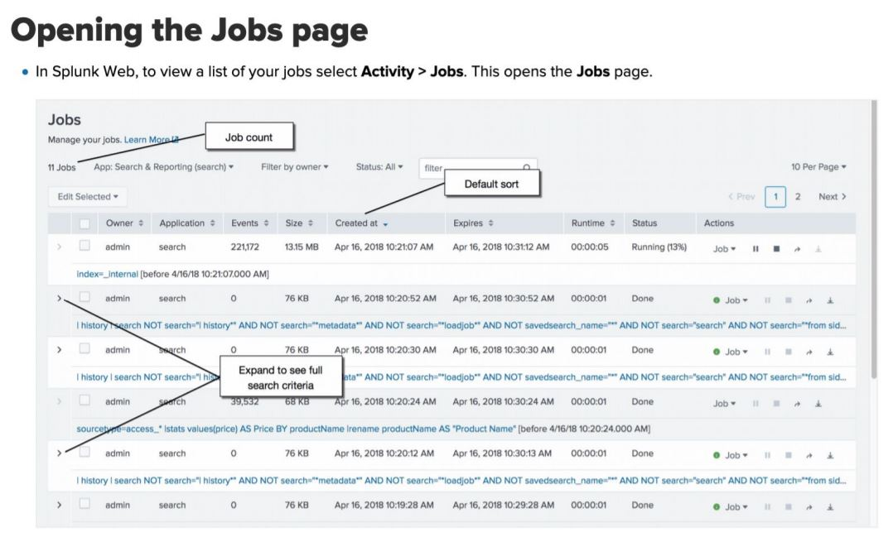
Search Jobs
Manage Search Jobs
Views and Compare
Inspect
Share
Delete

Slide 65
Outline
Introduce Splunk and the Search app
Run basic searches
What splunk is not good for
Recommended Log Formats
Identify the contents of search results
Control a search job
Lab: Use the output of a search to refine your search

Slide 66
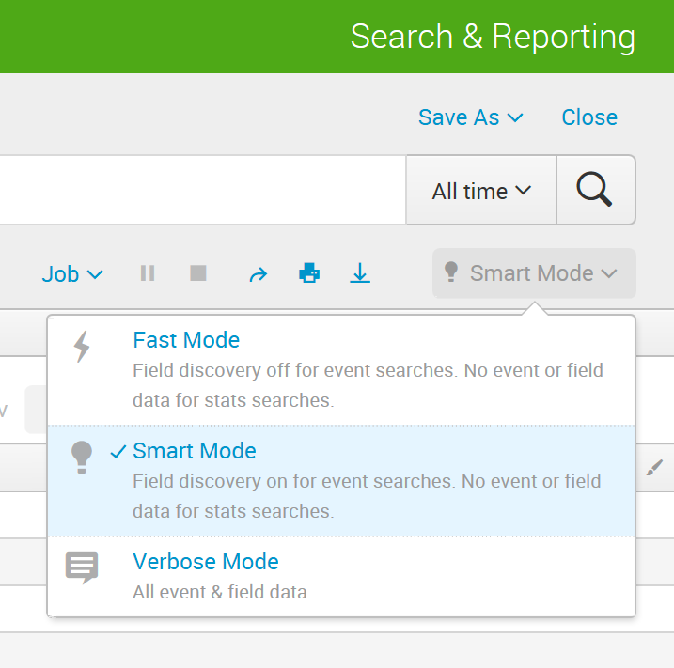
Search Modes, Fields, Discovery
The Search App has three modes
Fast
Smart
Verbose

Slide 67
Search Modes, Fields, Discovery
Fast
No field discovery, except the default metadata fields
Use if you know exactly which fields you need and can specify them in the search string
Smart
Returns the best results for whatever search you are running
Verbose
Discovers all fields it can
Use if you are not sure what fields you will want to report on

Slide 68
Search Modes, Fields, Discovery
Field Discovery
During field discovery, Splunk detects key=value pairs
error=failed
level=critical
The first 50 key=value pairs are displayed on the field browser on the left

Slide 69
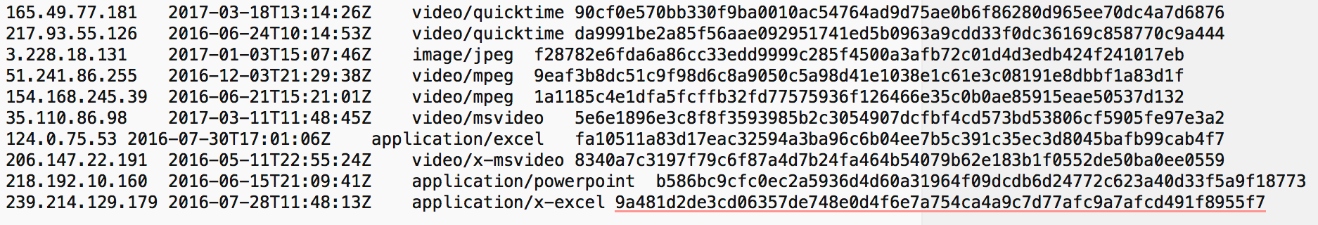
Search Modes, Fields, Discovery
Field Extraction
What if fields are not in nice, neat key=value pairs?
You can extract your own fields using the field extraction tools!

Slide 70
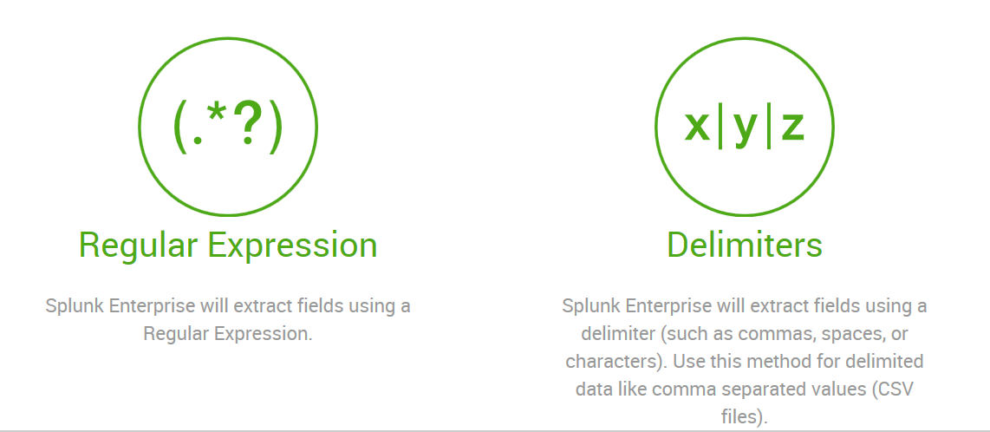
Search Modes, Fields, Discovery
Field Extraction
Field extraction works by using regular expressions.
Splunk comes with built-in tools to help you

Slide 71
Lab 02: Search Modes, Fields, and Field Extraction

Slide 72
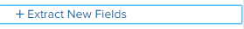
Search Modes, Fields, Discovery
Field Extraction
Extract New Field

Slide 73
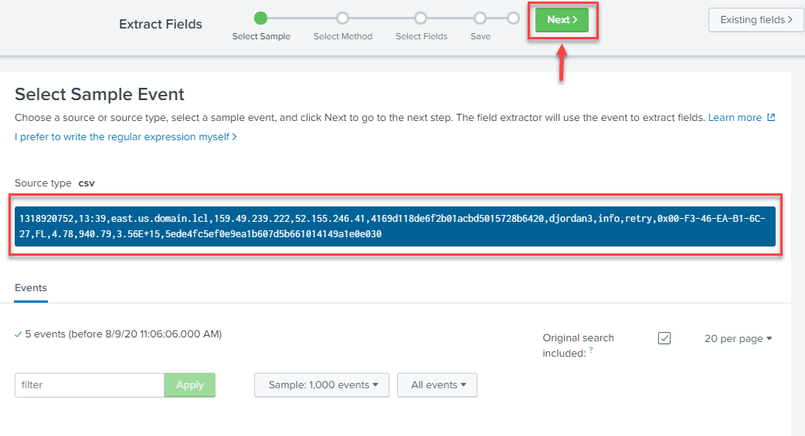
Search Modes, Fields, Discovery
Select the Sample Events and click on Next

Slide 74
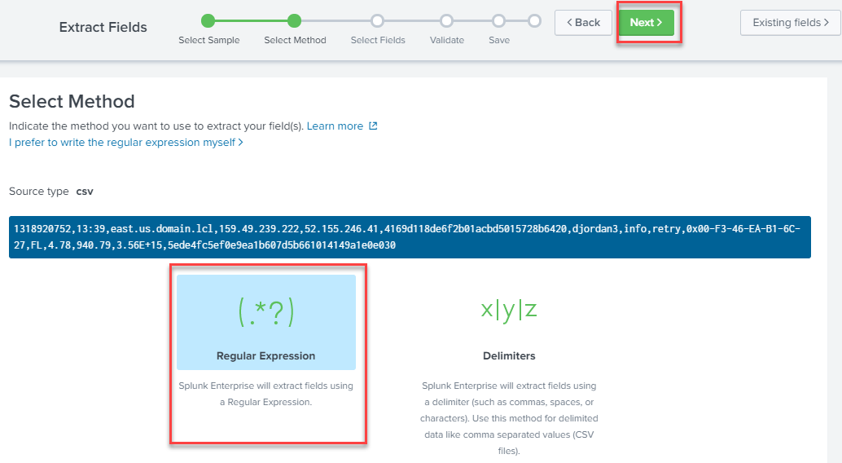
Search Modes, Fields, Discovery
Select Regular Expression and then click on Next.

Slide 75
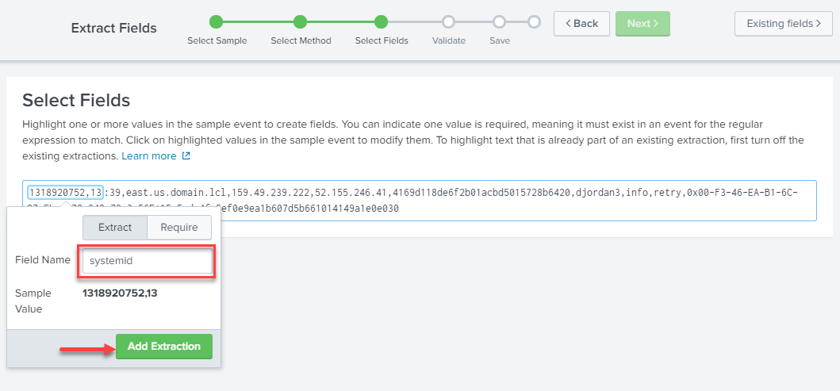
Search Modes, Fields, Discovery
Select Fields
Highlight one or more values in the sample event to create fields.

Slide 76
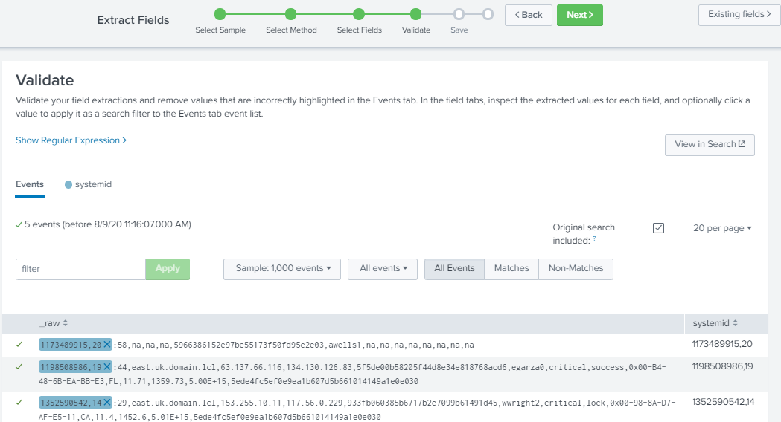
Search Modes, Fields, Discovery
Validate your field extractions and remove values that are incorrectly highlighted in the Events tab.

Slide 77
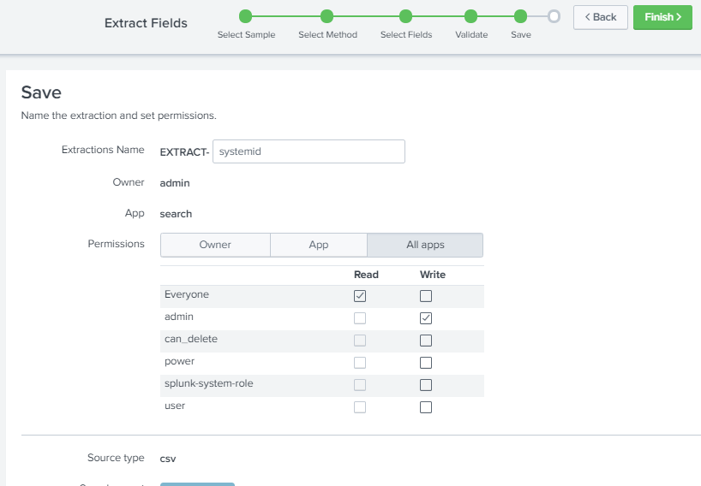
Search Modes, Fields, Discovery
Name the extraction and set permissions.

Slide 78
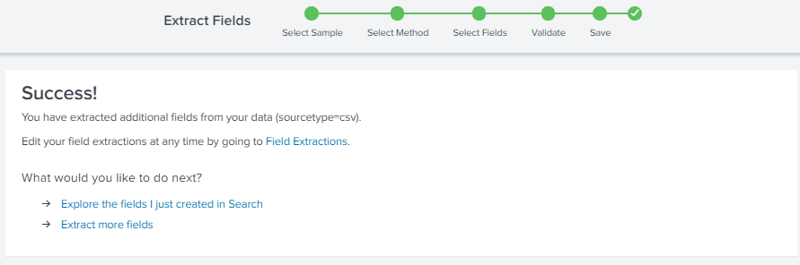
Search Modes, Fields, Discovery

Slide 79
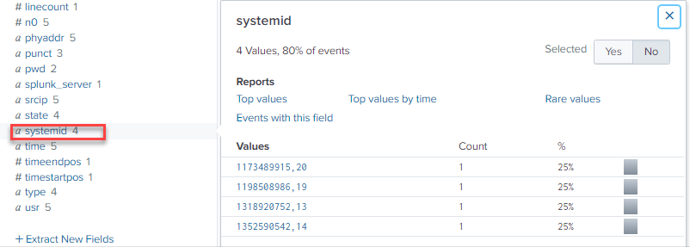
Search Modes, Fields, Discovery

Slide 80
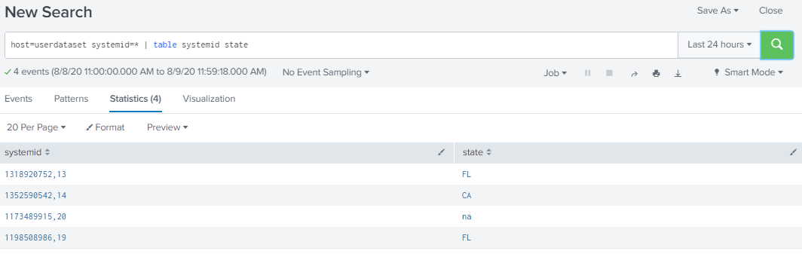
Search Modes, Fields, Discovery
Search the systemid
host=userdataset systemid=* | table systemid state

Slide 81
Splunk
END LAB 02

Slide 82
Lab 03: Searching Logs Data

Slide 83
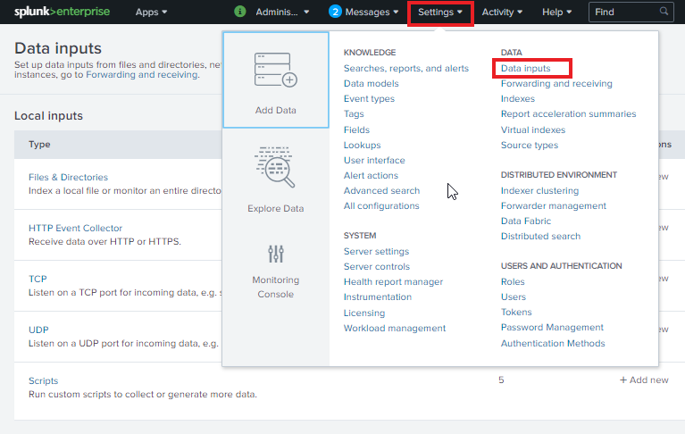
Searching Logs Data
Now on the top right corner, drop down the settings and under the data section, choose data inputs and go to the Files and Directories folder.

Slide 84
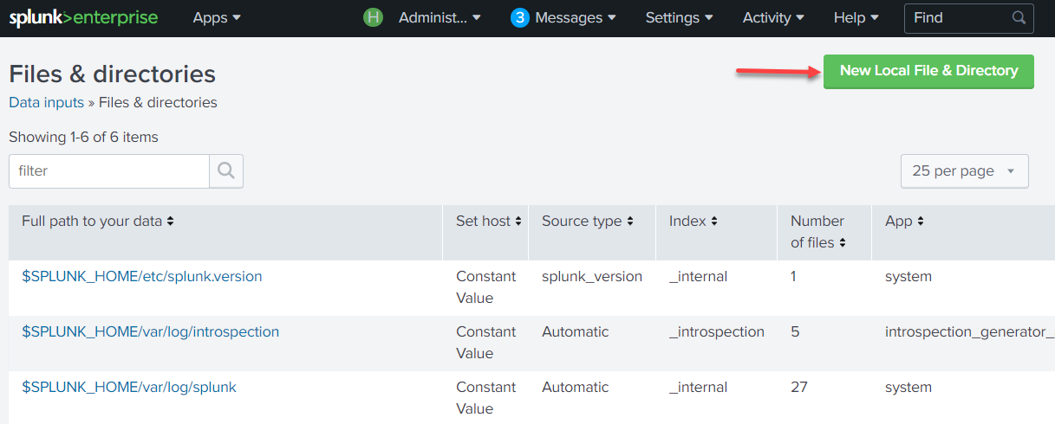
Searching Logs Data
Go to New Local File & Directory option.

Slide 85
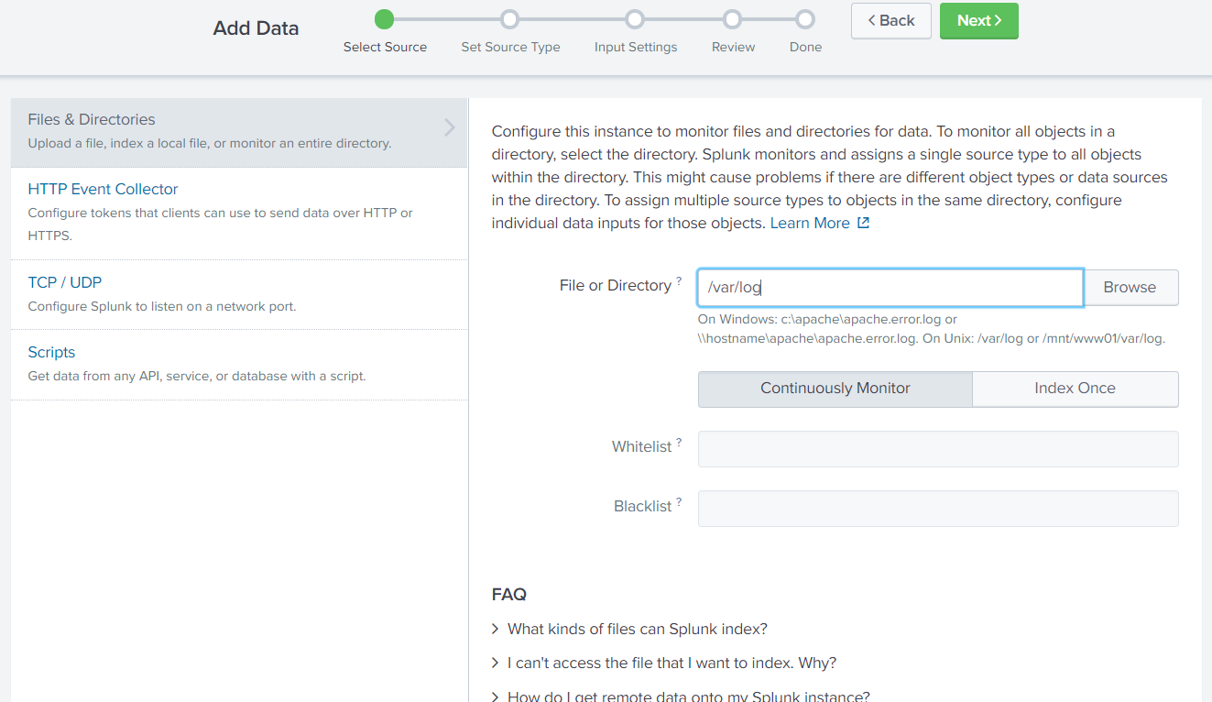
Searching Logs Data
Under Files or Directory, choose the directory /var/log and click next until the Done section.

Slide 86
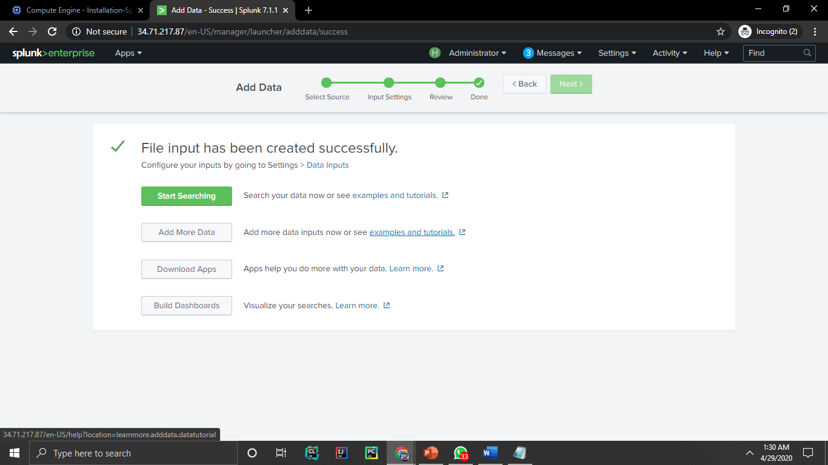
Searching Logs Data
Click on Start Searching option.

Slide 87
Searching Logs Data
We have successfully searched the log files and we can see the dashboard with all the events, patterns, statistics and visualizations. We have therefore successfully implemented splunk on GCP and have used the log file examples to search out great results!

Slide 88
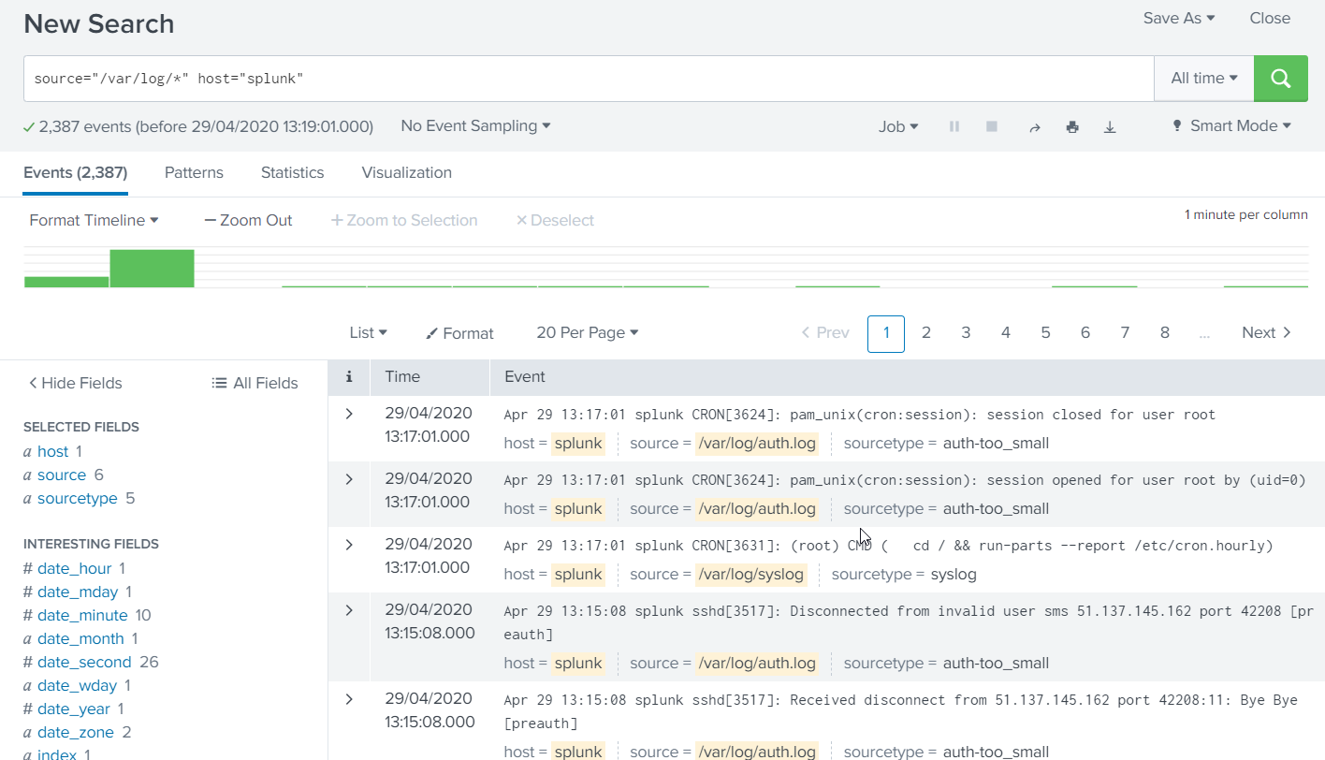
Searching Logs Data

Slide 89
Splunk
END LAB 03

Slide 90
Splunk
Chapter 2
Fundamentals

Slide 91

Course Overview
Start Searching
Fundamentals
Stats
Tags and Event Types
Creating Reports

Slide 92
Outline
Fundamentals:
Examine the anatomy of a search
Understand search language syntax concepts
Review fields and use the fields command
Create a table
Examine multivalue fields
Joins
Parallel Coordinates Query

Slide 93
Anatomy: Types of Search
Raw Event search : Raw event searches are searches that just retrieve events from an index or indexes, and are typically used when you want to analyze a problem.
Transforming searches : such as statistical calculation against a set of results. retrieve events from an index and then pass the events into one or more search commands.
Sparse searches are searches that look for a single event or an event that occurs infrequently within a large set of data.
Dense searches are searches that scan through and report on many events. Some examples of these searches include: counting the number of errors that occurred or finding all events from a specific host.

Slide 94
Outline
Fundamentals:
Examine the anatomy of a search
Understand search language syntax concepts
Review fields and use the fields command
Create a table
Examine multivalue fields
Joins
Parallel Coordinates Query

Slide 95
Understand Search Language Syntax Concepts
Understanding Search
To successfully use Splunk, it is vital that you write effective searches. Using the index efficiently will make your initial discoveries faster, and the reports you create will run faster for you and for others.
How to write effective searches
How to search using fields
Understanding time
Saving and sharing searches
Event annotation

Slide 96
Understand Search Language Syntax Concepts
Search terms :
Case insensitive : error, Error, ERROR, and ErRoR are all the same.
Additive: Search for Mary error, will get results contain both words
Boolean and grouping operators
AND is default .
For instance, error mary (two words separated by a space) is the same as error AND mary.
OR allows you to specify multiple values.
Ex: Error OR Mary means find any event that contains either word.

Slide 97
Understand Search Language Syntax Concepts
Search terms :
NOT applies to the next term or group.
Ex:, error NOT mary would find events that contain error but do not contain mary.
The quote marks ("") identify a phrase.
For example, "Out of this world" will find this exact sequence of words. Out of this world will find any event that contains all of these words

Slide 98
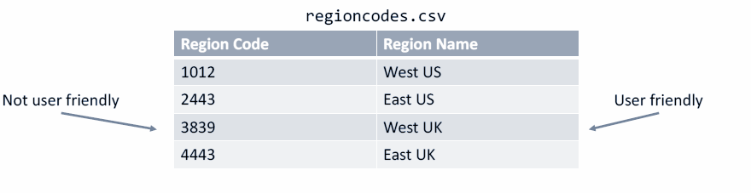
Input Lookup/Lookup
Lookups
Add custom fields to events from external sources, like csv files

Slide 99
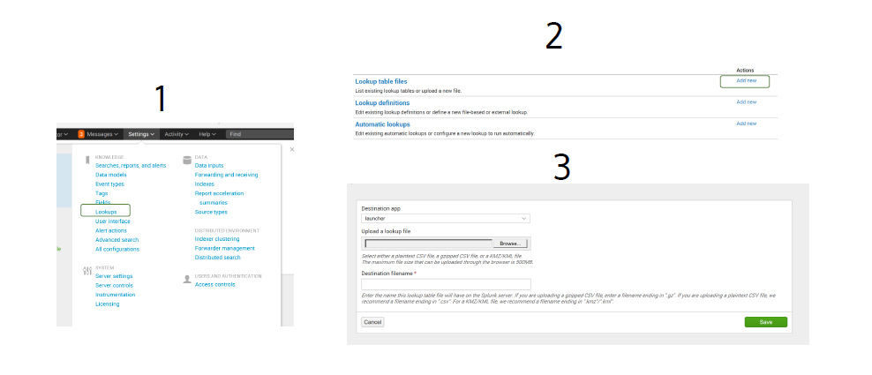
Input Lookup/Lookup
Lookups

Slide 100
Input Lookup/Lookup
Lookups
| lookup <lookup-table-name> <lookup-field1>
AS <event-field1>
| lookup regioncodes.csv “Region Code” AS
regcode

Slide 101
Splunk
LAB 04: Lookup

Slide 102
Input Lookup/Lookup
Lookups
test.csv
Now let's make a simple table with the table command and we'll do a log level which will show us the original values and colname2 which should show us the new values
index="_internal" log_level=* | lookup test.csv log_level OUTPUT colname2 | table log_level colname2

Slide 103
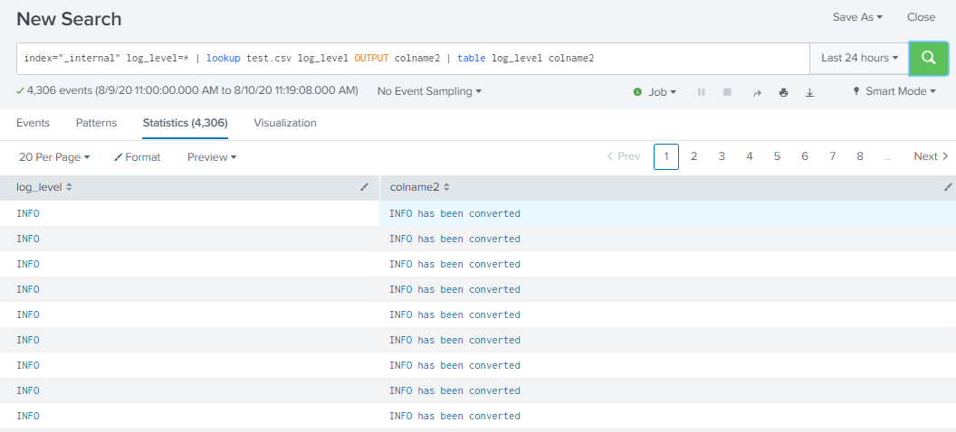

Slide 104
Splunk
END LAB 04

Slide 105
Dedup/Fillnull
Dedup
Removing redundant data is the point of the dedup filtering command. This command removes subsequent results that match specified criteria.
That is, this command keeps only the first count results for each combination of values of the specified fields. If count is not specified, it defaults to 1 and returns the first result found (which is usually the most recent)

Slide 106
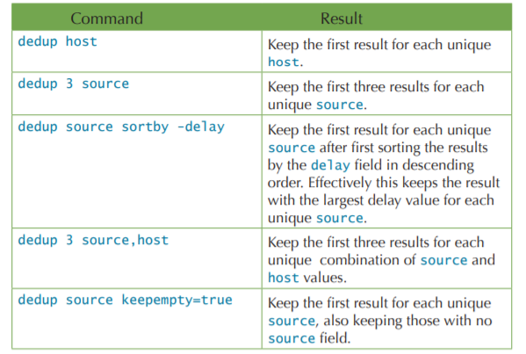
Dedup/Fillnull
Dedup Command Examples

Slide 107
SPL: Wildcards and Syntax
Though the index is based on words, it is possible to use wildcards when necessary, albeit a little carefully. Take a look at some interesting facts about wildcards:
Only trailing wildcards are efficient:
Stated simply, bob* will find events containing Bobby efficiently, but *by or *ob* will not. The latter cases will scan all events in the time frame specified.
Wildcards are tested last:
Wildcards are tested after all other terms. Given the search authclass *ob* hello world, all other terms besides *ob* will be searched first. The more you can limit the results using full words and fields, the better your search will perform

Slide 108
Outline
Fundamentals:
Examine the anatomy of a search
Understand search language syntax concepts
Review fields and use the fields command
Create a table
Examine multivalue fields
Joins
Parallel Coordinates Query

Slide 109
About Fields
Fields often appear in events as key=value pairs such as user_name=Fred. But in many events, field values appear in fixed, delimited positions without identifying keys. For example, you might have events where the user_name value always appears by itself after the timestamp and the user_id value.
Fields appear in event data as searchable name-value pairings such as user_name=fred or ip_address=192.168.1.1. Fields are the building blocks of Splunk searches, reports, and data models. When you run a search on your event data, Splunk software looks for fields in that data.
Look at the following example search.
status=404

Slide 110
About Fields Extraction
As Splunk software processes events, it extracts fields from them. This process is called field extraction.
Automatically-extracted fields:
Splunk software automatically extracts host, source, and sourcetype values, timestamps, and several other default fields when it indexes incoming events.
It also extracts fields that appear in your event data as key=value pairs. This process of recognizing and extracting k/v pairs is called field discovery. You can disable field discovery to improve search performance.

Slide 111
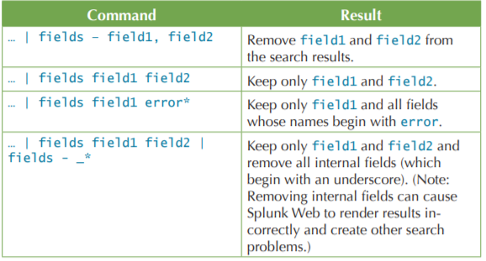
Field Command
The fields command removes fields from search results

Slide 112
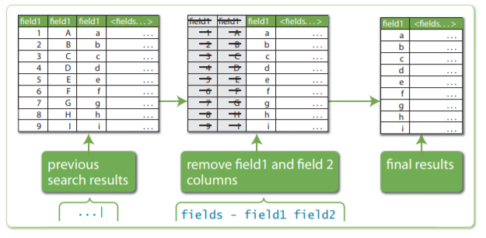
Field Command
Example:

Slide 113
Supplementing wildcards in fields
What if you only wanted the second event but all you know is that the event contains world somewhere in the field message? The query message="*world*" would work but it is very inefficient, because Splunk must scan every event looking for *world, and then determine whether world is present in the field message.
You can take advantage of the behavior mentioned earlier—wildcards are tested last. Rewriting the query as world message="*world*"

Slide 114
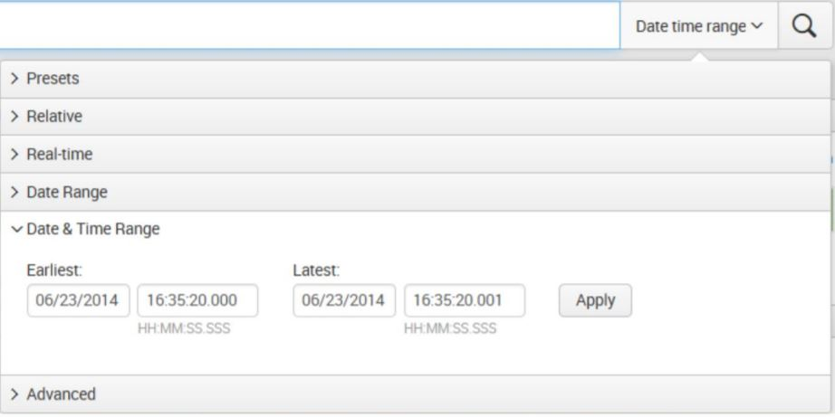
Different ways to search against time
The Date & Time Range picker provides a neat set of options for dealing with search times.
This picker widget is organized by:
Presets
Relative
Real-time
Data Range
Date & Time Range
Advanced

Slide 115
SPL
For example, you ran the following search to determine how many simulation games were purchased:
sourcetype=access_* status=200 action=purchase categoryId=simulation
To find this number for the days of the previous week, you need to run it against the data for each day of that week. To see which products are more popular than the other, run the search for each of the eight categoryId values and compare the results.

Slide 116
Use fields to Search
What are fields?
Fields exist in machine data in many forms. Often, a field is a value with a fixed, delimited position on a line, or a name and value pair, where there is a single value to each field name. A field can be multivalued, that is, a field in a single event can have multiple values in a field.
Some examples of fields are client ip for IP addresses accessing your Web server, _time for the timestamp of an event, and host for domain name of a server.

Slide 117
Use Fields to Search
One of the more common examples of multi value fields is email address fields. While the From field will contain only a single email address, the To and Cc fields have one or more email addresses associated with them.
Fields are searchable name and value pairings that distinguish one event from another. Not all events have the same fields and field values. Use fields to write more tailored searches to retrieve the specific events that you want.
When you search for fields, you use the syntax field_name=field_value.
Field names are case sensitive, but field values are not.
You can use wildcards in field values.
Quotation marks are required when the field values include spaces.

Slide 118
Splunk
LAB 05: Finding the Latest Events

Slide 119
Load DataSet
Upload sampledata.zip data in Splunk

Slide 120
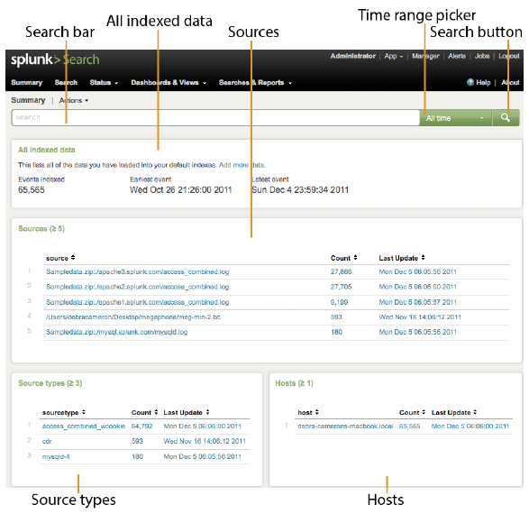
The Search app’s Summary dashboard

Slide 121
Lab: Finding the Latest Events
Problem
You need to find the latest event for each unique field value. For example, when was the last time each user logged in?
Solution
At first, you might be tempted to use the transaction or stats command. For example, this search returns, for each unique user, the first value seen for each field:
Notes:
Solution
At first, you might be tempted to use the transaction or stats command.
For example, this search returns, for each unique user, the first value seen for each field:
source="Sampledata.zip:*" host="sampledata" | stats first(*) by user
Note that this search returns the first value of each field seen for events that have the same userid. It provides a union of all events that have that user ID, which is not what we want. What we want is the first event with
a unique user. The proper way to do that is with the dedup command:
… | dedup user
Variations
If you want to get the oldest (not the newest) event with a unique user, use the sortby clause of the dedup command:
… | dedup user sortby + _time

Slide 122
Splunk
END LAB 05

Slide 123
Splunk
LAB 06: Search without a subsearch

Slide 124
Load DataSet
Upload access.log data in Splunk

Slide 125
Search without a subsearch
sourcetype=access_* status=200 action=purchase | top limit=1 clientip
sourcetype=access_* status=200 action=purchase clientip=87.194.216.51 | stats count, dc(productId), values(productId) by clientip
sourcetype=access_* status=200 action=purchase [search sourcetype=access_* status=200 action=purchase | top limit=1 clientip | table clientip] | stats count, dc(productId), values(productId) by clientip

Slide 126
Splunk
END LAB 06

Slide 127
Outline
Fundamentals:
Examine the anatomy of a search
Understand search language syntax concepts
Review fields and use the fields command
Create a table
Examine multivalue fields
Joins
Parallel Coordinates Query

Slide 128
Create a Table
...| table ip size url
your search | rename ip as IP, size as "Size in bytes", url as URL | table IP,
"Size in bytes", URL
index = _internal | stats count by action, host | table host count

Slide 129
Splunk
LAB 07: Create a Table
Search for recent earthquakes in and around Hawaii

Slide 130
Create a table
Search for recent earthquakes in and around Hawaii
The table command returns a table that is formed by only the fields that you specify in the arguments.
You can download a current CSV file from the USGS Earthquake Feeds and add it as an input to your Splunk deployment.

Slide 131
Example 1:
Search for recent earthquakes in and around Hawaii and display only the time of the quake (Datetime), where it occurred (Region), and the quake's magnitude (Magnitude) and depth (Depth).
host="earthquake_usage" sourcetype="csv" place=*California | table time, place, mag, depth

Slide 132
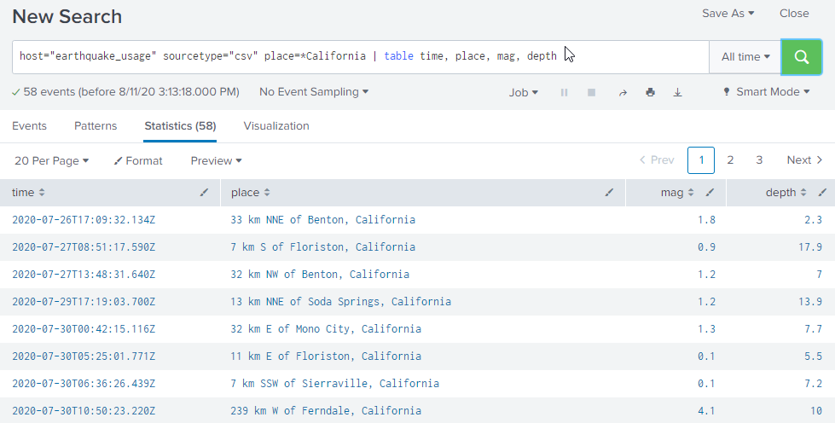
This simply reformats your events into a table and displays only the fields that you specified as arguments.

Slide 133
Splunk
END LAB 07

Slide 134
Splunk
LAB 08: Create a Table
Show the date, time, coordinates, and magnitude of each recent earthquake in Northern California.

Slide 135
Example 2:
Show the date, time, coordinates, and magnitude of each recent earthquake in Northern California.
host="earthquake_usage" sourcetype="csv" place=*California | rename lat as latitude lon as longitude | table time, place, lat*, lon*, mag

Slide 136
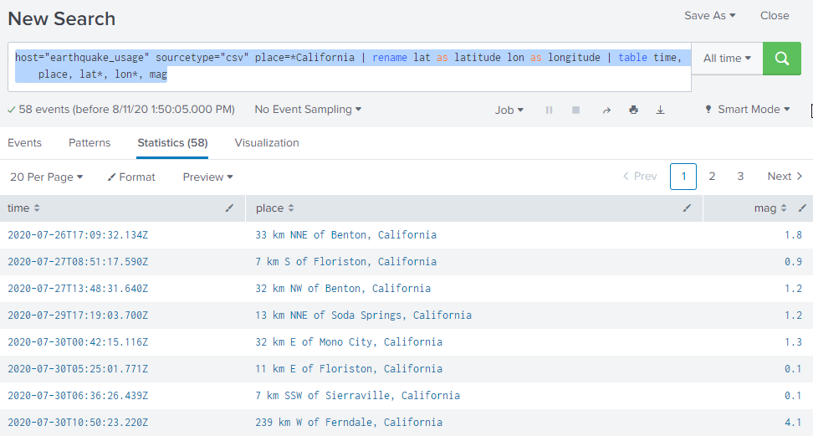

Slide 137
Splunk
END LAB 08

Slide 138
Outline
Fundamentals:
Examine the anatomy of a search
Understand search language syntax concepts
Review fields and use the fields command
Create a table
Examine multivalue fields
Joins
Parallel Coordinates Query

Slide 139
Examine multivalue fields
Multivalue fields are parsed at search time, which enables you to process the values in the search pipeline. Search commands that work with multivalue fields include makemv, mvcombine, mvexpand, and nomv.
Evaluate multivalue fields
One of the more common examples of multivalue fields is email address fields, which typically appear two or three times in a single sendmail event--one time for the sender, another time for the list of recipients, and possibly a third time for the list of Cc addresses.

Slide 140
Examine multivalue fields
Count the number of values in a field
Use the mvcount() function to count the number of values in a single value or multivalue field.
In this example, mvcount() returns the number of email addresses in the To, From, and Cc fields and saves the addresses in the specified "_count" fields.
.. | eval To_count=mvcount(split(To,"@"))-1 | eval From_count=mvcount(From) | eval Cc_count= mvcount(split(Cc,"@"))-1
Notes:
This search takes the values in the To field and uses the split function to separate the email address on the @ symbol. The split function is also used on the Cc field for the same purpose.
If only a single email address exists in the From field, as you would expect, mvcount(From) returns 1. If there is no Cc address, the Cc field might not exist for the event. In that situation mvcount(cc) returns NULL.

Slide 141
Examine multivalue fields
Filter values from a multivalue field
Use the mvfilter() function to filter a multivalue field using an arbitrary Boolean expression. The mvfilter function works with only one field at a time.
In this example, mvfilter() keeps all of the values for the field email that end in .net or .org.
.. | eval email=mvfilter(match(email, "\.net$") OR match(email, "\.org$"))
This example also uses the match() function to compare the pattern defined in quotes to the value of email

Slide 142
Outline
Fundamentals:
Examine the anatomy of a search
Understand search language syntax concepts
Review fields and use the fields command
Create a table
Examine multivalue fields
Joins
Parallel Coordinates Query

Slide 143
Join
Description
Use the join command to combine the results of a subsearch with the results of a main search. One or more of the fields must be common to each result set. You can also combine a search result set to itself using the selfjoin command. If you are familiar with SQL but new to SPL, see Splunk SPL for SQL users.

Slide 144
Syntax
join [join-options...] [field-list] subsearch
Required arguments
Subsearch
Syntax: "[" subsearch "]"
Description: A secondary search where you specify the source of the events that you want to join to. The subsearch must be enclosed in square brackets. The results of the subsearch should not exceed available memory.

Slide 145
Examples
Example 1
Combine the results from a main search with the results from a subsearch search vendors. The result sets are joined on the product_id field, which is common to both sources.
... | join product_id [search vendors]

Slide 146
Examples
Example 2
If the field names in the sources do not match, you can rename the field in the subsearch result set. The field in the main search is product_id. The field in the subsearch is pid.
Note: The field names must match in name and in case. You cannot join product_id with product_ID.
... | join product_id [search vendors | rename pid AS product_id]

Slide 147


Slide 148


Slide 149


Slide 150
Transactions
A transaction is a group of conceptually-related events that spans time. A transaction type is a transaction that has been configured in transactiontypes.conf and saved as a field.
Transactions can include:
Different events from the same source and the same host.
Different events from different sources from the same host.
Similar events from different hosts and different sources.

Slide 151
Transactions
For example, a customer purchase in an online store could generate a transaction that ties together events from several sources:
A set of web access events share a session ID with....
....a corresponding event in the application server log, which also contains related account, product, and transaction IDs. The transaction ID in that application server event also appears in…
...a message queue event, which contains a message ID. This message ID is in turn shared by...
...a purchase fulfillment event logged by the fulfillment application, which also includes the shipping status of the item that the customer purchased.

Slide 152
Transaction Search
A transaction search enables you to identify transaction events that each stretch over multiple logged events. Use the transaction command and its options to define a search that returns transactions (groups of events). See the documentation of the command in the Search Reference for a variety of examples that show you how you can:
Findgroups of events where the first and last events are separated by a span of time that does not exceed a certain amount (set with the maxspan option)
Find groups of events where the span of time between included events does not exceed a specific value (set with the maxpause option).

Slide 153
Transaction Search
Find groups of related events where the total number of events does not exceed a specific number (set with the maxevents option).
Design a transaction that finds event groups where the final event contains a specific text string (set with the endswith option). Study the transaction command topic to get the full list of available options for the command. You can also use the transaction command to override transaction options that you have configured in transactiontypes.conf

Slide 154
Outline
Fundamentals:
Examine the anatomy of a search
Understand search language syntax concepts
Review fields and use the fields command
Create a table
Examine multivalue fields
Joins
Parallel Coordinates Query

Slide 155
Parallel Coordinates Query
The parallel coordinates query syntax returns results in a table with multiple columns. Columns represent each dimension in the query and an optional count or other aggregation field.
Query syntax
To generate a parallel coordinates visualization, use this query syntax.
... | <stats_function> by <dimension_field1>[, <dimension_field2>, ... <dimension_fieldN>] [ | fields -count ]

Slide 156
Splunk
LAB 09: Parallel Coordinates Query
Parallel coordinates query tracking fat and calorie

Slide 157

Lab: Using erex, regex, rex
Load data file into Splunk
Click on “Add Data”

Slide 158

Lab: Using erex, regex, rex
Click on “Upload”

Slide 159

Parallel Coordinates Query
Here is a parallel coordinates query tracking fat and calorie information for different food groups.
| inputlookup nutrients.csv | head 2500 | stats count by group, "fat (g)", "calories"
The query generates a table with columns for the food group, additional dimensions, and the count.

Slide 160
Splunk
END LAB 09

Slide 161
Splunk
Chapter 3
Stats

Slide 162
Course Overview
Start Searching
Fundamentals
Stats
Tags and Event Types
Creating Reports

Slide 163
Outline
Stats:
Understand the stats command
Display top and rare values for given fields
EventStats vs StreamStats

Slide 164
Outline
Stats:
Understand the stats command
Display top and rare values for given fields

Slide 165
Stats
Calculates aggregate statistics, such as average, count, and sum, over the results set. This is similar to SQL aggregation. If the stats command is used without a BY clause, only one row is returned, which is the aggregation over the entire incoming result set. If a BY clause is used, one row is returned for each distinct value specified in the BY clause.
The stats command can be used for several SQL-like operations.

Slide 166
Stats
Syntax
Simple: stats (stats-function(field) [AS field])... [BY field-list]
Complete: stats [partitions=<num>] [allnum=<bool>] [delim=<string>] (<stats-agg-term> ... | <sparkline-agg-term>... ) [<by-clause>]

Slide 167
Syntax
Required arguments
stats-agg-term
Syntax:
<stats-func>( <evaled-field>| <wc-field>) [AS<wc-field> ] Description: A statistical aggregation function. See Stats function options. The function can be applied to an eval expression, or to a field or set of fields. Use the AS clause to place the result into a new field with a name that you specify. You can use wildcard characters in field names. For more information on eval expressions, see Types of eval expressions in the Search Manual.

Slide 168
Splunk
LAB 10: Stats Basic Examples

Slide 169
Basic Examples
Return the average transfer rate for each host
sourcetype=access* | stats avg(kbps) BY host
Search the access logs, and return the total number of hits from the top 100 values of "referer_domain"
Search the access logs, and return the total number of hits from the top 100 values of "referer_domain". The "top" command returns a count and percent value for each "referer_domain".
sourcetype=access* | top limit=100 referer_domain | stats sum(count) AS total

Slide 170
Splunk
END LAB 10

Slide 171
Outline
Stats:
Understand the stats command
Display top and rare values for given fields
EventStats vs StreamStats

Slide 172
top
Finds the most common values for the fields in the field list. Calculates a count and a percentage of the frequency the values occur in the events. If the <by-clause> is included, the results are grouped by the field you specify in the <by-clause> .
Syntax
top [N] [<top-options>...] <field-list> [<by-clause>]
Required arguments
<field-list>

Slide 173
top
Syntax:
<field>, <field>,...
Description:
Comma-delimited list of field names.

Slide 174
Splunk
LAB 11: Return the 20 most common values for a field

Slide 175

Examples
Example 1: Return the 20 most common values for a field
This search returns the 20 most common values of the "referer" field. The results show the number of events (count) that have that a count of referer, and the percent that each referer is of the total number of events.
sourcetype=access_* | top limit=20 referer

Slide 176
Splunk
END LAB 11

Slide 177
Splunk
LAB 12: Return top values for one field organized by another field

Slide 178
Examples
Example 2 : Return top values for one field organized by another field
This search returns the top "action" values for each "referer_domain".
sourcetype=access_* | top action by referer_domain
Because a limit is not specified, this returns all the combinations of values for "action" and "referer_domain" as well as the counts and percentages:

Slide 179

Examples

Slide 180
Splunk
END LAB 12

Slide 181
Splunk
LAB 13: Specifying multiple aggregations and multiple by-clause fields

Slide 182
LAB
Problem
Specifying multiple aggregations and multiple by-clause fields
Solution
This search organizes the incoming search results into groups based on the combination of host and sourcetype. It returns the sum of the bytes in the Sum of bytes field and the average bytes in the Average field for each group. If there are two distinct hosts and two distinct sourcetypes, the search will produce results similar to this:
sourcetype=access_* | stats sum(bytes) AS "Sum of bytes", avg(bytes) AS Average BY host, sourcetype

Slide 183
Splunk
END LAB 13

Slide 184
rare
Displays the least common values of a field. Finds the least frequent tuple of values of all fields in the field list. If the <by-clause> is specified, this command returns rare tuples of values for each distinct tuple of values of the group-by fields. This command operates identically to the top command, except that the rare command finds the least frequent instead of the most frequent.
Syntax
rare [<top-options>...] <field-list> [by-clause]

Slide 185
Examples
Return the least common values in a field
Return the least common values in the "url" field. Limits the number of values returned to 5.
... | rare url limit=5
Return the least common values organized by host
Find the least common values in the "user" field for each "host" value. By default, a maximum of 10 results are returned.
... | rare user by host

Slide 186
Outline
Stats:
Understand the stats command
Display top and rare values for given fields
EventStats vs StreamStats

Slide 187
Outline
Stats:
Understand the stats command
Display top and rare values for given fields
EventStats vs StreamStats

Slide 188
EventStats vs StreamStats
The eventstats command computes the same statistics as the stats command, but it also aggregates the results to the original raw data.
When you run the following search, it returns an events list instead of a results table, because the eventstats command does not change the raw data.
sourcetype=access_* | head 10 | eventstats sum(bytes) as ASumOfBytes by clientip

Slide 189
EventStats vs StreamStats
The streamstats command also aggregates the calculated statistics to the original raw event, but it does this at the time the event is seen.
To demonstrate this, include the _time field in the earlier search and use streamstats.
sourcetype=access_* | head 10 | sort _time | streamstats sum(bytes) as ASumOfBytes by clientip | table _time, clientip, bytes, ASumOfBytes

Slide 190
Splunk
Chapter 4
Tags and Event Types

Slide 191
Course Overview
Start Searching
Fundamentals
Stats
Tags and Event Types
Creating Reports

Slide 192
Outline
Tags and Event Types
Understand the eval command
Perform calculations on field values
Convert round and format field values
Use conditional statements
Using REX and RegEx

Slide 193
eval
The eval command calculates an expression and puts the resulting value into a search results field.
If the field name that you specify does not match a field in the output, a new field is added to the search results.
If the field name that you specify matches a field name that already exists in the search results, the results of the eval expression overwrite the values in that field.

Slide 194
eval
The eval command evaluates mathematical, string, and boolean expressions.
Syntax
eval <field>=<expression> ["," <field>=<expression>]...

Slide 195
Syntax
The syntax of the eval expression is checked before running the search, and an exception is thrown for an invalid expression.
The result of an eval expression cannot be Boolean. If, at search time, the expression cannot be evaluated successfully for a given event, eval erases the resulting field.
If the expression references a field name that contains non-alphanumeric characters, it needs to be surrounded by single quotation marks. For example, if the field name is server-1 you specify the field name like this new=count+'server-1'.

Slide 196
Syntax
If the expression references literal strings it needs to be surrounded by double quotation marks. For example, if the string you want to use is server- you specify the string like this new="server-".host.

Slide 197
Usage
The eval command is a distributable streaming command.
General: When you use the eval command, you must specify a field name. The results of the that you want to evaluate are placed in that field.
Functions: You can use a wide range of functions with the eval command. Operators: The following table lists the basic operations you can perform with the eval command.

Slide 198

Usage

Slide 199
Splunk
LAB 14: Basic Examples

Slide 200
Basic Examples
Create a new field that contains the result of a calculation
Create a new field called velocity in each event. Calculate the velocity by dividing the values in the distance field by the values in the time field.
... | eval velocity=distance/time
Use the if function to determine the values placed in the status field Create a field called status in each event.
Using the if function, set the value in the status field to OK if the error value is 200. Otherwise set the status value to Error.
... | eval status = if(error == 200, "OK", "Error")

Slide 201
Splunk
END LAB 14

Slide 202

Difference between eval and stats command
The stats command calculates statistics based on fields in your events. The eval command creates new fields in your events by using existing fields and an evaluation expression.

Slide 203
Outline
Tags and Event Types
Understand the eval command
Perform calculations on field values
Convert round and format field values
Use conditional statements
Using REX and RegEx

Slide 204
Dealing with Time
Timestamp
(n) A default field that represents time information in an event. Most events contain timestamps. In cases where an event does not contain timestamp information, Splunk Enterprise attempts to assign a timestamp value to the event at index time.

Slide 205
Dealing with Time
The _time field
A Splunk-generated default field that represents time.
Timestamps are usually added automatically based on the event raw data.
If time and date information are not included in the event raw data, Splunk attempts to “guess” at a timestamp.
As a last resort, Splunk will set the timestamp to the system time.

Slide 206


Dealing with Time
Splunk uses the timestamp information for the time selector in the search bar.

Slide 207
Dealing with Time
Time Conversion
Time can be converted from Splunk’s default to a format of your choice using the strftime() eval function
| eval time=strftime(_time, “%H:%M”)

Slide 208
Dealing with Time
Time Conversion
Time variable | Description
%H | Hour (24 hour clock)
%I | Hour (12 hour clock)
%M | Minute
%S | Second
%p | AM or PM

Slide 209
Dealing with Time
Date Conversion
Time variable | Description
%A | Full day name
%d | Day of the month (01 – 31)
%e | Day of the month without leading zero (1 – 31)
%B | Full month name (January)
%b | Abbreviated month name (Jan)
%m | Month as a number (01 – 12)
%Y | Four digit year (2017)
%y | Two digit year (17)

Slide 210
Dealing with Time
Time Conversion for 1:07:32 p.m.
String | Timestamp
%I:%M %p
%H:%M
%H:%M:S
%S

Slide 211
Dealing with Time
Time Conversion for January 20, 2017 1:07:32 p.m.
String | Timestamp
%d %B %Y %I:%M %p
%H:%M %b %y
%y%Y%y%Y

Slide 212
Splunk
LAB 15: Dealing with Time

Slide 213
Dealing with Time
Time Conversion
Upload userdataset
Simple Scenario that's going to have a timestamp and a user name
host="userdataset" usr=* | table _time usr

Slide 214

Timestamp and a username

Slide 215
Dealing with Time
Time Conversion
Another Example
Now see the 12 hour marker and the minute marker and also see the AM or PM marker
host="userdataset" usr=* | eval timestamp=strftime(_time,"%I:%M %p") | table timestamp usr

Slide 216

Result

Slide 217
Dealing with Time
Time Conversion
Another Example
Bring the date before time information
host="userdataset" usr=* | eval timestamp=strftime(_time,"%d %B,%I:%M %p") | table timestamp usr

Slide 218

Result

Slide 219
Splunk
END LAB 15

Slide 220
Dealing with Time
Review
_time is a Splunk-generated default field that represents time.
Timestamps are usually added automatically based on the event raw data.
Time data is used for the time picket in the web GUI.
You can force your own time format using variables that begin with %.

Slide 221
Outline
Tags and Event Types
Understand the eval command
Perform calculations on field values
Convert round and format field values
Use conditional statements
Using REX and RegEx

Slide 222
REX
Syntax
rex [field=<field>] (<regex-expression> [max_match=] [offset_field=<string>] ) | (mode=sed <sed-expression>)
Required arguments
regex-expression
Syntax: <string>
Description: The PCRE regular expression that defines the information to match and extract from the specified field. Quotation marks are required.

Slide 223
REX
Mode
Syntax: mode=sed
Description: Specify to indicate that you are using a sed (UNIX stream editor) expression.

Slide 224
REX
sed-expression
Syntax: “<string>”
Description: When mode=sed, specify whether to replace strings (s) or substitute characters (y) in the matching regular expression. No other sed commands are implemented. Quotation marks are required. Sed mode supports the following flags: global (g) and Nth occurrence (N), where N is a number that is the character location in the string

Slide 225
REX
Optional arguments
Field
Syntax: field=<field>
Description: The field that you want to extract information from.
Default: _rawmax_
Match
Syntax: max_match=<int>
Description: Controls the number of times the regex is matched. If greater than 1, the resulting fields are multivalued fields.
Default: 1, use 0 to mean unlimited.offset_

Slide 226
REX
Field
Syntax: offset_field=<string>
Description: If provided, a field is created with the name specified by . This value of the field has the endpoints of the match in terms of zero-offset characters into the matched field. For example, if the rex expression is "(?<tenchars>.{10})", this matches the first ten characters of the field, and the offset_field contents is "0-9".
Default: unset

Slide 227
Splunk
LAB 16: Create a statistical report based on search results

Slide 228
Lab: Create a statistical report based on search results
Problem: We would need to produce a report by request type, url and status code. How many requests were passed, failed and so on in an hour.
Following log statements.
[05/Jun/2018:07:25:03 +0000] "GET /healthcheck.jsp HTTP/1.1" 200 259 0 [a10hm/1.0] [-] inbound-8080-1 [-]
[05/Jun/2018:07:25:03 +0000] "GET /healthcheck.jsp HTTP/1.1" 200 259 0 [a10hm/1.0] [-] inbound-8080-232 [-]
[05/Jun/2018:07:25:06 +0000] "DELETE /appname/account/1.0/records/2222005725 HTTP/1.1" 500 235 392 [Apache-HttpClient/4.3.6.redhat-1 (java 1.5)] [0] inbound-8080-15 [-]
[05/Jun/2018:11:00:01 +0000] "PUT /appname/account/1.0/records/4754600006 HTTP/1.1" 500 249 553 [Apache-HttpClient/4.3.6.redhat-1 (java 1.5)] [198] inbound-8080-119 [-]

Slide 229

Lab: Create a statistical report based on search results - Solution
sourcetype=access_* | rex "\"(?<requestType>\w+)\s(?<url>[^\s]+)\s.*\"\s(?<status>\d+)\s(?<size>\d+)\s(?<time>\d+)" | stats count(eval(status==200)) as passed count(eval(status!=200)) as failed by requestType url status

Slide 230
ReGex
Why?
Regex is helpful in transforming your horrible looking machine logs into beautiful human understandable reports and dashboard -Easy to understand and use.

Slide 231
Splunk
END LAB 16

Slide 232
ReGex
How?
Splunk automatically identifies any fields that match its key/value pair intelligence, which can be found to the left of the search results as below. This can often allow you to start putting together useful data visualizations right out of the box.
In below screenshot Splunk has automatically extracted host, timestamp etc values. We can use these values for reporting, statistical analysis and creating dashboards. Splunk has inbuilt regex extractor called IFX (Interactive field extractor). By using IFX splunk auto detects useful fields and list them at left side.

Slide 233
ReGex
How?
Splunk IFX can extract fields automatically which are in standard key value pair format i.e. key=value format like username=john etc.But if logs are not in key value pair format then you have to teach splunk to extract fields which you wan using regex.

Slide 234
Examples
• expression matches
abc: abc (the "exact" character sequence, but anywhere in the string)
^abc: abc (at the beginning of the string)
abc$: abc (at the end of the string)
https://docs.splunk.com/Documentation/Splunk/7.0.2/Knowledge/AboutSplunkregularexpressions

Slide 235
ReGex
The regex command removes results that do not match the specified regular expression.
Syntax regex (<field>=<regex-expression> |<field>!=<regex-expression> |<regex-expression>)
Example 1: Keep only search results whose "_raw" field contains IP addresses in the non-routable class A (10.0.0.0/8). This example uses a negative lookbehind assertion at the beginning of the expression.
... | regex
_raw="(?<!\d)10\.\d{1,3}\.\d{1,3}\.\d{1,3}(?!\d)"

Slide 236
ReGex
Example 2: Keep only the results that match a valid email address. For example, buttercup@example.com.
...| regex email="/^([a-z0-9_\.-]+)@([\da-z\.-]+)\.([a-z\.]{2, 6})$/" >>>>>>> ed0d74d381be859b5455078d358704c9b133ad3b

Slide 237
Sed Expression
When using the rex command in sed mode, you have two options: replace (s) or character substitution (y).
The syntax for using sed to replace (s) text in your data is:
"s/<regex>/<replacement>/<flags>"
<regex>is a PCRE regular expression, which can include capturing groups.
<replacement>is a string to replace the regex match. Use \n for backreferences, where "n" is a single digit.
<flags>can be either: g to replace all matches, or a number to replace a specified match.

Slide 238
Sed Expression
The syntax for using sed to substitute characters is: "y/<string1>/<string2>/"
This substitutes the characters that match <string2> with the characters in <string> .
https://docs.splunk.com/Documentation/Splunk/7.0.2/SearchReference/Rex

Slide 239
Differences between rex and regex
Rex- Description
Use this command to either extract fields using regular expression named groups, or replace or substitute characters in a field using sed expressions.
The rex command matches the value of the specified field against the unanchored regular expression and extracts the named groups into fields of the corresponding names.
If a field is not specified, the regular expression is applied to the _raw field. Note: Running rex against the _raw field might have a performance impact. When mode=sed, the given sed expression used to replace or substitute characters is applied to the value of the chosen field.

Slide 240
Differences between rex and regex
Rex- Description (Cont..)
If a field is not specified, the sed expression is applied to _raw. This sed-syntax is also used to mask sensitive data at index-time.
Read about using sed to anonymize data in the Getting Data In Manual. Use the rex command for search-time field extraction or string replacement and character substitution.

Slide 241
Differences between rex and regex
Regex- Description
The regex command removes results that do not match the specified regular expression. or, this regex command prints out the results that match the specified regular expression.
Normally you would use "rex". regex is, generally less-required than rex. so, as a beginner, if you are got confusion of which one to use "rex or regex", normally you would required to use "rex".

Slide 242
Examples for rex and regex
Example for REX
Extract "from" and "to" fields using regular expressions. If a raw event contains "From: Susan To: Bob", then from=Susan and to=Bob.
... | rex field=_raw "From: (?<from>.*) To: (?<to>.*)"

Slide 243
Examples for rex and regex
Example for Regex
Keep only search results whose "_raw" field contains IP addresses in the non-routable class A (10.0.0.0/8). This example uses a negative lookbehind assertion at the beginning of the expression.
... | regex _raw="(?<!\d)10\.\d{1,3}\.\d{1,3}\.\d{1,3}(?!\d)"

Slide 244
Outline
Tags and Event Types
Understand the eval command
Perform calculations on field values
Convert round and format field values
Use conditional statements
Using REX and RegEx

Slide 245
Splunk
LAB 17: Using erex, regex, rex

Slide 246
Lab: Using erex, regex, rex
Load data file into Splunk
Click on “Add Data”

Slide 247
Lab: Using erex, regex, rex
Click on “Upload”

Slide 248

Lab: Using erex, regex, rex
Click on “Select File” and choose your file name

Slide 249

Lab: Using erex, regex, rex
After uploading your data, choose the next option at the top right corner with default configurations..
Give a name to your Source type and then click on save

Slide 250

Lab: Using erex, regex, rex
Click on Start Searching after you successfully upload your data

Slide 251
Lab: Using erex, regex, rex
Use Splunk to generate regular expressions by providing a list of values from the data.
Execute below command(s):
| makeresults | eval month_text = "07/02,11/03,13/3,01/03,99/3" | erex months examples="07/02,01/03" counterexamples="99/3" fromfield=month_text

Slide 252

Lab: Using erex, regex, rex
Result

Slide 253
Lab: Using erex, regex, rex
Regex Command Filter Using Regular Expressions
Execute below command(s):
index=main | regex _raw = "From:\s+<[[:alnum:]]+@[[:alnum:]]+\.[[:alpha:]]+>"

Slide 254

Lab: Using erex, regex, rex
Result

Slide 255
Lab: Using erex, regex, rex
rex Command
Extract Fields Using Regular Expressions
Search Time … | rex field={what_field} “FrontAnchor(?{characters}+)BackAnchor”
index="main" | rex field=_raw "From:\s+<(?<from>.*)>\s+To:\s+<(?<to>.*)>\s+"

Slide 256

Lab: Using erex, regex, rex
Result

Slide 257
Lab: Using erex, regex, rex
rex Command
Extract Fields Using Regular Expressions
| makeresults | eval text = "user_id=bob;search;my_saved_search" | rex field=text "user_id={1}(?<user>\w+);(?<app_name>\w+);(?<saved_search_name>\w+)"

Slide 258

Lab: Using erex, regex, rex
Result

Slide 259
Lab: Using erex, regex, rex
rex Command
Extract Fields Using Regular Expressions
| makeresults | eval credit_card_number = "1234-5678-9101-1213" | rex field=credit_card_number max_match=0 "(?<digits>\d{4})"

Slide 260

Lab: Using erex, regex, rex
Result

Slide 261
Lab: Using erex, regex, rex
rex Command
Extract Fields Using Regular Expressions
| makeresults | eval credit_card_number = "1234-5678-9101-1213" | rex field=credit_card_number offset_field="new_field" max_match=0 "(?<digits>\d{4})"

Slide 262

Lab: Using erex, regex, rex
Result

Slide 263
Lab: Using erex, regex, rex
rex Command
Extract Fields Using Regular Expressions
| makeresults | eval credit_card_number = "1234-5678-9101-1213" | rex field=credit_card_number mode=sed "s/(\d{4}-){3}/XXXX-XXXX-XXXX-/g"

Slide 264

Lab: Using erex, regex, rex
Result

Slide 265
Lab: Using erex, regex, rex
rex Command
Extract Fields Using Regular Expressions
| makeresults | eval credit_card_number = "1234-5678-9101-1213" | rex field=credit_card_number mode=sed "s/(\d{4})/XXXX/4"

Slide 266

Lab: Using erex, regex, rex
Result

Slide 267
Lab: Using erex, regex, rex
rex Command
Extract Fields Using Regular Expressions
| makeresults | eval credit_card_number = "1234-5678-9101-1213" | rex field=credit_card_number mode=sed "y/1234/XXXX/"

Slide 268

Lab: Using erex, regex, rex
Result

Slide 269
Splunk
END LAB 17

Slide 270
Tips-Pretty Searches
Keep it Simple
Weak :
| rename machine as “host for later” | rename net as Subnet | sort “host for later” | timechart count by “host for later” span=1h
Strong :
| timechart span=1h count by machine | sort machine | rename machine AS “host for later”, Net as Subnet

Slide 271
Tips-Pretty Searches
Notes :
new pipe = new line + space + pipe
| <commands> <params> <processing>
cosmetics at end combine multiple renames and rexs

Slide 272
Splunk
Chapter 5
Creating Reports

Slide 273
Course Overview
Start Searching
Fundamentals
Stats
Tags and Event Types
Creating Reports

Slide 274
Outline
Creating Reports
Create reports and charts
Chart Functions
Split values into multiple series
Apply statistical functions

Slide 275
Create Reports
When you create a search or a pivot that you would like to run again or share with others, you can save it as a report.
You can create reports via Splunk Web four ways:
From Search, by saving a search as a report.
From Pivot, by saving a pivot as a report.
By selecting Settings > Searches, reports, and alerts and clicking New Report to add a new report.
From a dashboard, by converting an inline-search-powered dashboard panel to a report.

Slide 276
Chart
The chart command is a transforming command that returns your results in a table format. The results can then be used to display the data as a chart, such as a column, line, area, or pie chart.
You must specify a statistical function when you use the chart command
Syntax
chart [<chart-options>] [agg=<stats-agg-term>] ( <stats-agg-term>| | "("<eval-expression>")" )... [ BY <row-split> <cloumn-split>] | [ OVER <row-split>] [BY <column-split>] [<dedup_splitvals>]

Slide 277
Outline
Creating Reports
Create reports and charts
Chart Functions
Split values into multiple series
Apply statistical functions

Slide 278
Chart Functions
list(X)
Description: Returns a list of up to 100 values of the field X as a multivalue entry. The order of the values reflects the order of input events.
Usage
If more than 100 values are in field X, only the first 100 are returned.
This function processes field values as strings.
You can use the list(X) function with the chart, stats, and timechart commands.

Slide 279
Chart Functions
values(X)
Description: Returns the list of all distinct values of the field X as a multivalue entry. The order of the values is lexicographical.
Usage
By default there is no limit to the number of values returned. Users with the appropriate permissions can specify a limit in the limits.conf file. You specify the limit in the [stats | sistats] stanza using the maxvalues setting.
This function processes field values as strings.
You can use the values(X) function with the chart, stats, and timechart commands.

Slide 280
Outline
Creating Reports
Create reports and charts
Chart Functions
Split values into multiple series
Apply statistical functions

Slide 281
Splunk
LAB 18: Split Data into Multiple Columns

Slide 282
Split Data into Multiple Columns
| makeresults
| eval _raw="1. xyz 2. dsh bh 3. sdh dsd() 4. trrt"
| rex field=_raw "(?<a>\d+)\.\s(?<b>[^\d]*)(?:$|\s)" max_match=0
| eval c=mvzip(a,b)
| mvexpand c
| eval no=mvindex(split(c,","),0), name=mvindex(split(c,","),1)
| rex field=name mode=sed "s/\(\)//g"
| table no, name

Slide 283

Result

Slide 284
Splunk
END LAB 18

Slide 285
Splunk
LAB 19: Remove Null Entries from Chart

Slide 286
Lab: Remove Null Entries from Chart
| makeresults | eval host="host1",T1=null(),T2="1",T3="2" | append [| makeresults | eval host="host1",T1="2",T2="4",T3="5"]| append [| makeresults | eval host="host1",T1="2",T2=null(),T3="5"]| append [| makeresults | eval host="host1",T1=null(),T2=null(),T3="6"]| eval found_all=if(isnull(T1) OR isnull(T2) OR isnull(T3),"No","Yes")

Slide 287

Lab: Remove Null Entries from Chart

Slide 288
Splunk
END LAB 19

Slide 289
Outline
Creating Reports
Create reports and charts
Chart Functions
Split values into multiple series
Apply statistical functions

Slide 290

Statistical Functions
The following table lists the commands supported by the statistical and charting functions and the related command that can also use these functions.

Slide 291
Statistical Functions
Using an eval expression in a statistical function is a shortcut for specifying an eval command that creates a field, followed by a stats command that references that field.
For example::
... | stats count(eval(status="404")) AS count_status BY sourcetype

Slide 292
Required arguments
You must include one of the following arguments when you use the chart command.
Stats-agg-term
Syntax:
<stats-func> ( <evaled-field> | <wc-field>) [AS <wc-field>]
Description: A statistical aggregation function. See Stats function options. The function can be applied to an eval expression, or to a field or set of fields. Use the AS clause to place the result into a new field with a name that you specify. You can use wildcard characters in field names.

Slide 293
Required arguments
sparkline-agg-term
Syntax: <sparkline-agg> [AS <wc-field> ]
Description: A sparkline aggregation function. Use the AS clause to place the result into a new field with a name that you specify. You can use wild card characters in field names. See Sparkline options.

Slide 294
Required arguments
eval-expression
Syntax:
<eval-math-exp> | <eval-concat-exp> | <eval-compare-exp> | <eval-bool-exp>| <eval-function-call>
Description: A combination of literals, fields, operators, and functions that represent the value of your destination field. For more information, see the Evaluation functions

Slide 295
Splunk
Chapter 6
Bonus

Slide 296
Bonus: Faster Searching
Less is more :
Weak: iphone | stats count by action| search action=AppleWebKit
Strong: iphone action=AppleWebKit | stats count
Require Fields:
Weak: iphone | stats count by action
(Wrong Results:Pulls both phone=iphone and user_agent=*iphone* )
Strong: phone=iphone action=* | stats count by action

Slide 297
Bonus: Faster Searching
Be specific :
Weak: iphone| stats count by action
Strong: index=oidemo host=dmzlog.splunktel.com sourcetype=access_combined source=/opt/apache/log/access_combined.log iphone user_agent="*iphone*” | stats count by action
Time selector and eventypes/tags!

Slide 298
Bonus: Faster Searching
stats vs dedup/transaction
Weak: … phone=*| dedup phone | table phone | sort phone
... phone=*| transaction host | table host, phone
Strong: ... phone=*| stats count by phone, host | fields - count
Pro Tip:
• Table is cosmetic
• Fields is reducing

Slide 299
Bonus: Faster Searching
foreach is clean
Weak: ...| timechart span=1h limit=0 sum(eval(b/pow(1024,3))) as size by st
Strong: ...| timechart span=1h limit=0 sum(b) by st | foreach * [ eval <<FIELD>> = '<FIELD>' / pow( 1024 , 3 ) ]
coalesce’s cooler than if (Null Values):
Weak: ...| eval size = if( isnull(bytes) , if( isnull(b) , "N/A" , b ) , bytes )
Strong: ...| eval size = coalesce( bytes , b , "N/A" )

Slide 300
Faster Searches
Avoid Subsearches
Weak: index=burch | eval blah=yay| append [search index=simon | eval blah=duh]
Strong: ( index=burch ... ) OR ( index=simon ...)| eval blah=case( index==”burch" , "yay" , index==”simon" ,"duh" )
NOT NOTs :
Weak: index=burch NOT blah=yay blah=cool
Strong: index=burch blah=duh index=burch blah!=yay

Slide 301
Search Commands: Tips
Transaction
Weak: ...| transaction host (More data, More problems! )
Strong: ...| transaction maxspan=10m maxevents=100 …

Slide 302
Search Commands: Tips
Time and Units
Weak: ...| eval new_time =<ridiculous strings edit>
Strong: ...| convert ctime(duration) ...| bin span=1h _time
...| eval pause = tostring( pause , “duration” )
...| rename new_time as _time

Slide 303
Search Commands: Tips
metadata:
Weak: index=* | stats count by host
Strong: | metadata index=* type=hosts
eventcount :
Weak: index=*| stats count by index
Strong: | eventcount summarize=false index=*

Slide 304
Reference
Splunk documentation: https://docs.splunk.com/Documentation/Splunk/latest/SearchTutorial/WelcometotheSearchTutorial
Exploring Splunk: https://www.splunk.com/pdfs/exploring-splunk.pdf

Slide 305
Thank You!

